Slide 1
Welcome to Microsoft Defender Day 2

Slide 2
A look into Day 2
Kick-Off | 8:00-8:05 | Welcome | Main Call
 | 8:05-8:30 | Attack Patterns + Analysis
 | 8:30-8:45 | Demo Walkthrough
Ingest | 8:45-9:00 | Break
 | 9:00-10:00 | Attack Patterns + Catching Attacks
 | 10:00-11:00 | Activity: Attack Patterns | Table Group Call
 | 11:00-12:00 | Build Hands-on: Attack Simulation
 | 12:00-1:00 | Long Break | Table Group Call
Transform | 1:00-2:00 | Windows Defender, Attack Analysis, Emerging Threats | Main Call
 | 2:00-2:30 | Restoring Systems
 | 2:30-2:45 | Break
 | 2:45-3:15 | Activity: Restoring Systems
 | 3:15-4:00 | Build Hands-on: Restoring Systems | Table Group Call
 | 4:00-4:15 | Closing | Main Call
Today we will be learning and collaborating across three spaces:
Main call (this meeting)
Table Group channel within the event Team
CloudLabs Learner Portal & Lab environment
Presentation/
Whole Group
Lab
Activity/ Discussion/ Group Work
Announcements

Slide 3
Attack Patterns and Analysis

Slide 4
MITRE ATT&CK

Slide 5

MITRE ATT&CK
Adversarial Tactics, Techniques, and Common Knowledge (ATT&CK)
MITRE started ATT&CK in 2013 to document common tactics, techniques, and procedures (TTPs) that advanced persistent threats use against Windows enterprise networks.
Globally-accessible knowledge base of adversary tactics and techniques based on real-world observations.
The ATT&CK knowledge base is used as a foundation for the development of specific threat models and methodologies in the private sector, in government, and in the cybersecurity product and service community.
Notes:
MITRE ATT&CK®

Slide 6
Framework Terms
Tactics - Tactics represent the “why” of an ATT&CK technique or sub-technique. It is the adversary’s tactical goal: the reason for performing an action.
Techniques - Techniques represent “how” an adversary achieves a tactical goal by performing an action.
Sub-techniques - more specific description of the adversarial behavior used to achieve a goal. They describe behavior at a lower level than a technique.
Procedures - Procedures are the specific implementation the adversary uses for techniques or sub-techniques. For example, a procedure could be an adversary using PowerShell to inject into lsass.exe to dump credentials by scraping LSASS memory on a victim.
Notes:
MITRE ATT&CK®

Slide 7
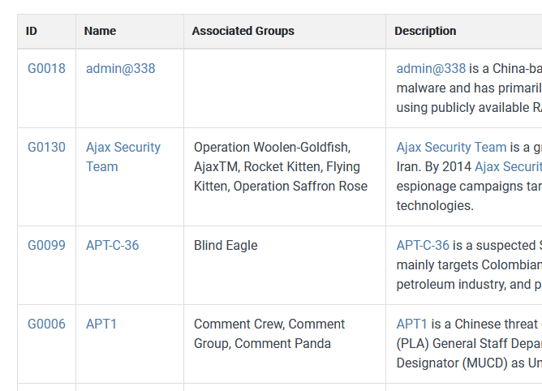
Groups
Groups are sets of related intrusion activity that are tracked by a common name in the security community.
Some groups have multiple names associated with similar activities due to various organizations tracking similar activities by different names.
Organizations' group definitions may partially overlap with groups designated by other organizations and may disagree on specific activity.
Common groups : FIN7, Carbanak (Carbon Spider)
Notes:
https://attack.mitre.org/groups/
Fin7 - https://attack.mitre.org/groups/G0046/
Carbanak - https://attack.mitre.org/groups/G0008/

Slide 8
Enterprise Techniques
Reconnaissance (TA0043) - The adversary is trying to gather information they can use to plan future operations.
Resource Development (TA0042) - The adversary is trying to establish resources they can use to support operations.
Initial Access (TA0027) - The adversary is trying to get into your network.
Execution (TA0041) -The adversary is trying to run malicious code.
Persistence (TA0028) - The adversary is trying to maintain their foothold.
Privilege Escalation (TA0029) - The adversary is trying to gain higher-level permissions.
Defense Evasion (TA0030) -The adversary is trying to avoid being detected.
Credential Access (TA0031) - The adversary is trying to steal account names and passwords.

Slide 9
Enterprise Techniques (Cont)
Discovery (TA0032) - The adversary is trying to figure out your environment.
Lateral Movement (TA0033) - The adversary is trying to move through your environment.
Collection (TA0035) - The adversary is trying to gather data of interest to their goal.
Command and Control (TA0037) - The adversary is trying to communicate with compromised systems to control them.
Exfiltration (TA0036) - The adversary is trying to steal data.
Impact (TA0034) - The adversary is trying to manipulate, interrupt, or destroy your systems and data.
Network Effects (TA0038) - The adversary is trying to intercept or manipulate network traffic to or from a device.
Remote Service Effects (TA0039) - The adversary is trying to control or monitor the device using remote services.

Slide 10
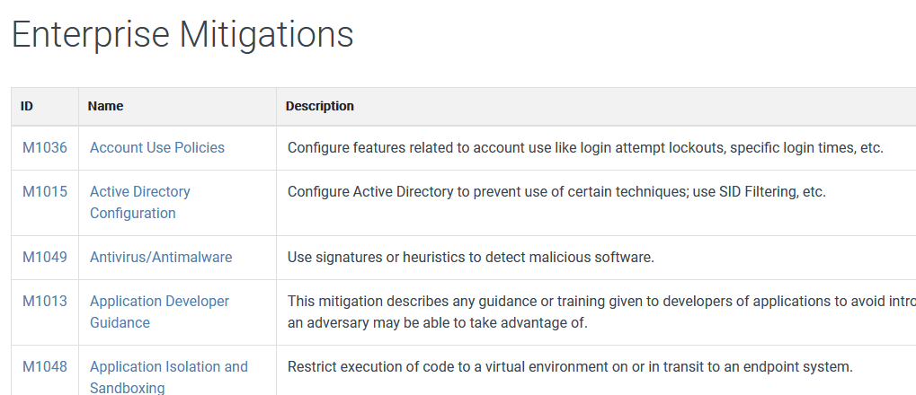
Mitigations
Mitigations are defined and attached to the various techniques and sub-techniques.
Notes:
https://attack.mitre.org/mitigations/enterprise/

Slide 11


Question…
Where are places where MITRE Attack Framework is referenced across Microsoft?
Notes:
You can find MITRE references across most of the Microsoft Security portals:
Azure Defender
Azure Sentinel
Microsoft Defender 365 Portals

Slide 12
Thank You slide
Break (15 mins)

Slide 13
Welcome Back!
Kick-Off | 8:00-8:05 | Welcome | Main Call
 | 8:05-8:30 | Attack Patterns + Analysis
 | 8:30-8:45 | Demo Walkthrough
Ingest | 8:45-9:00 | Break
 | 9:00-10:00 | Attack Patterns + Catching Attacks
 | 10:00-11:00 | Activity: Attack Patterns | Table Group Call
 | 11:00-12:00 | Build Hands-on: Attack Simulation
 | 12:00-1:00 | Long Break | Table Group Call
Transform | 1:00-2:00 | Windows Defender, Attack Analysis, Emerging Threats | Main Call
 | 2:00-2:30 | Restoring Systems
 | 2:30-2:45 | Break
 | 2:45-3:15 | Activity: Restoring Systems
 | 3:15-4:00 | Build Hands-on: Restoring Systems | Table Group Call
 | 4:00-4:15 | Closing | Main Call
Presentation/
Whole Group
Lab
Activity/ Discussion/ Group Work
Announcements

Slide 14
Attack Patterns

Slide 15
Attack Patterns
Malware is a term used to describe malicious applications and code that can cause damage and disrupt normal use of devices.
Malware can allow unauthorized access, use system resources, steal passwords, lock you out of your computer and ask for ransom, and more.
Cybercriminals that distribute malware are often motivated by money and will use infected computers to launch attacks, obtain banking credentials, collect information that can be sold, sell access to computing resources, or extort payment from victims.
Notes:
https://docs.microsoft.com/en-us/windows/security/threat-protection/intelligence/understanding-malware

Slide 16
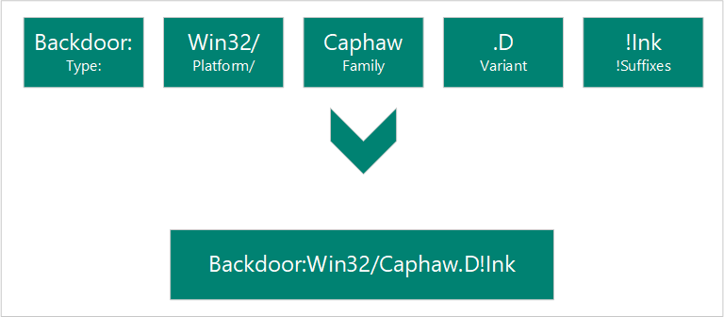
Malware Naming
Computer Antivirus Research Organization (CARO)
Components (Type, Platform, Family, Variant, !Suffixes)
Notes:
https://docs.microsoft.com/en-us/windows/security/threat-protection/intelligence/malware-naming

Slide 17
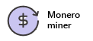
Coin Miners
Mining is the process of running complex mathematical calculations necessary to maintain the blockchain ledger. This process generates coins but requires significant computing resources.
Coin miners aren't inherently malicious.
These coin miners aren't wanted in enterprise environments because they eat up precious computing resources.
Cybercriminals see an opportunity to make money by running malware campaigns that distribute, install, and run trojanized miners at the expense of other people’s computing resources.
Example:
Trojan:Win32/Coinminer
Exploit:O97M/DDEDownloader.PA
Trojan:PowerShell/Maponeir.A
Notes:
Coin miners - Windows security | Microsoft Docs

Slide 18
Exploits and exploit kits
Exploits are often the first part of a larger attack.
Hackers scan for outdated systems that contain critical vulnerabilities, which they then exploit by deploying targeted malware.
Exploits often include shellcode, which is a small malware payload used to download additional malware from attacker-controlled networks.
Shellcode allows hackers to infect devices and infiltrate organizations.
Exploit kits are more comprehensive tools that contain a collection of exploits. These kits scan devices for different kinds of software vulnerabilities and, if any are detected, deploy additional malware to further infect a device.
Kits can use exploits targeting a variety of software, including Adobe Flash Player, Adobe Reader, Internet Explorer, Oracle Java, and Sun Java.
Notes:
Exploits and exploit kits - Windows security | Microsoft Docs

Slide 19
Exploits Naming
A project called "Common Vulnerabilities and Exposures (CVE)" is used by many security software vendors.
The project gives each vulnerability a unique number
For example, CVE-2016-0778.
The portion "2016" refers to the year the vulnerability was discovered.
The "0778" is a unique ID for this specific vulnerability.
https://cve.mitre.org/
Notes:
Exploits and exploit kits - Windows security | Microsoft Docs
https://cve.mitre.org/

Slide 20
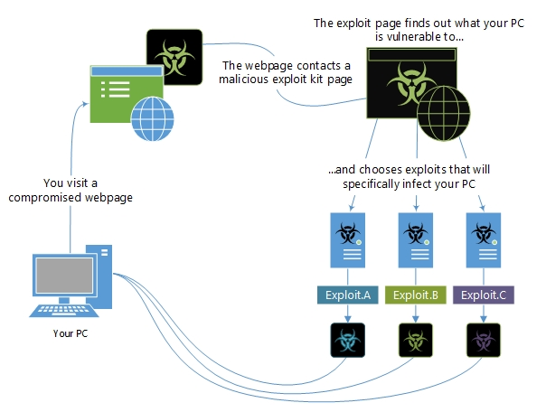
Exploits and exploit kits

Slide 21
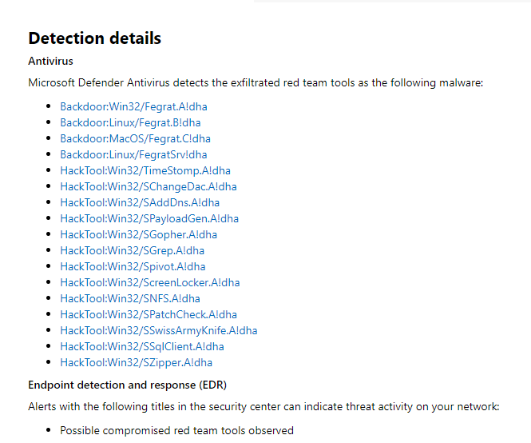
Exploits and exploit kits - FireEye
FireEye revealed that a highly sophisticated actor gained access to their red team tools
https://security.microsoft.com/threatanalytics3/a43fc0c6-120a-40c5-a948-a9f41eef0bf9/analystreport
Notes:
https://security.microsoft.com/threatanalytics3/a43fc0c6-120a-40c5-a948-a9f41eef0bf9/analystreport

Slide 22
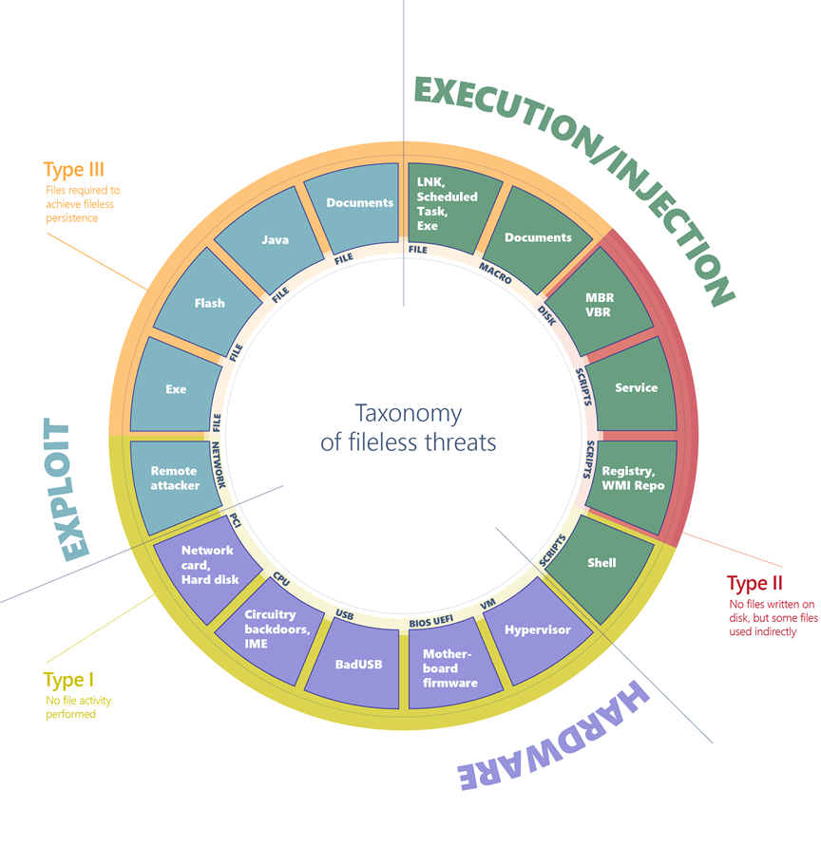
Fileless threats
Type I: No file activity performed
Type II: Indirect file activity
Type III: Files required to operate
Notes:
https://docs.microsoft.com/en-us/windows/security/threat-protection/intelligence/fileless-threats

Slide 23
Type I
A fully fileless malware can be considered one that never requires writing a file on the disk.
All these examples don't require a file on the disk to run, and can theoretically live only in memory. Infections of this type can be particularly difficult to detect because most antivirus products don’t have the capability to inspect firmware.
The malicious code would survive reboots, disk reformats, and OS reinstalls.
Example : Target machine receives malicious network packets that exploit the EternalBlue vulnerability. The vulnerability allows the installation of the DoublePulsar backdoor, which ends up residing only in the kernel memory. In this case, there's no file or any data written on a file.
Example : A compromised device may also have malicious code hiding in device firmware (such as a BIOS), a USB peripheral (like the BadUSB attack), or in the firmware of a network card.
Notes:
https://docs.microsoft.com/en-us/windows/security/threat-protection/intelligence/fileless-threats

Slide 24
Type II
There are other ways that malware can achieve fileless presence on a machine without requiring significant engineering effort. Fileless malware of this type doesn't directly write files on the file system, but they can end up using files indirectly.
Example : the Poshspy backdoor install a malicious PowerShell command within the WMI repository and configured a WMI filter to run the command periodically.
It’s possible to carry out such installation via command line without requiring a backdoor to already be on the file.
The malware can be installed and theoretically run without ever touching the file system.
However, the WMI repository is stored on a physical file in a central storage area managed by the CIM Object Manager, and usually contains legitimate data.
Notes:
https://docs.microsoft.com/en-us/windows/security/threat-protection/intelligence/fileless-threats

Slide 25
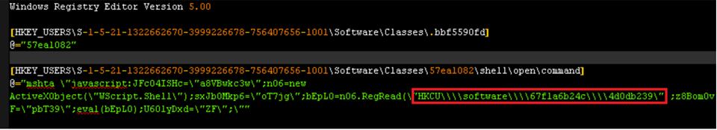
Type III
Some malware can have a sort of fileless persistence, but not without using files to operate.
Example: Kovter creates a shell open verb handler in the registry for a random file extension. Opening a file with such extension will lead to the execution of a script through the legitimate tool mshta.exe.
Notes:
https://docs.microsoft.com/en-us/windows/security/threat-protection/intelligence/fileless-threats

Slide 26
Macro malware
Macro malware hides in Microsoft Office files and is delivered as email attachments or inside ZIP files.
These files use names that are intended to entice or scare people into opening them.
They often look like invoices, receipts, legal documents, and more.
Macro malware was fairly common several years ago because macros ran automatically whenever a document was opened.
In recent versions of Microsoft Office, macros are disabled by default.
Notes:
Macro malware - Windows security | Microsoft Docs

Slide 27
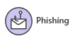
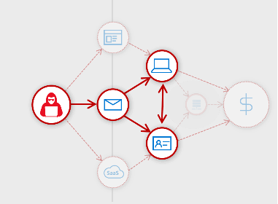
Phishing
Phishing attacks attempt to steal sensitive information through emails, websites, text messages, or other forms of electronic communication.
They try to look like official communication from legitimate companies or individuals.
Cybercriminals often attempt to steal usernames, passwords, credit card details, bank account information, or other credentials.
They use stolen information for malicious purposes, such as hacking, identity theft, or stealing money directly from bank accounts and credit cards.
Notes:
How to protect against phishing attacks - Windows security | Microsoft Docs

Slide 28
Ransomware
Ransomware is a type of malware that encrypts files and folders, preventing access to important files.
Ransomware attempts to extort money from victims by asking for money, usually in form of cryptocurrencies, in exchange for the decryption key.
Cybercriminals won't always follow through and unlock the files they encrypted.
Once ransomware infects a device, it starts encrypting files, folders, entire hard drive partitions using encryption algorithms like RSA or RC4.

Slide 29
Rootkits
Malware authors use rootkits to hide malware on your device, allowing malware to persist as long as possible.
A successful rootkit can potentially remain in place for years if it's undetected.
During this time, it will steal information and resources.
Rootkits intercept and change standard operating system processes. After a rootkit infects a device, you can’t trust any information that device reports about itself.
Example: If you were to ask a device to list all of the programs that are running, the rootkit might stealthily remove any programs it doesn’t want you to know about.
Notes:
Rootkits - Windows security | Microsoft Docs

Slide 30
Supply chain attacks
Supply chain attacks are an emerging kind of threat that target software developers and suppliers.
The goal is to access source codes, build processes, or update mechanisms by infecting legitimate apps to distribute malware.
Attackers hunt for unsecure network protocols, unprotected server infrastructures, and unsafe coding practices. They break in, change source codes, and hide malware in build and update processes.
Because software is built and released by trusted vendors, these apps and updates are signed and certified.
In software supply chain attacks, vendors are likely unaware that their apps or updates are infected with malicious code when they’re released to the public. The malicious code then runs with the same trust and permissions as the app.

Slide 31
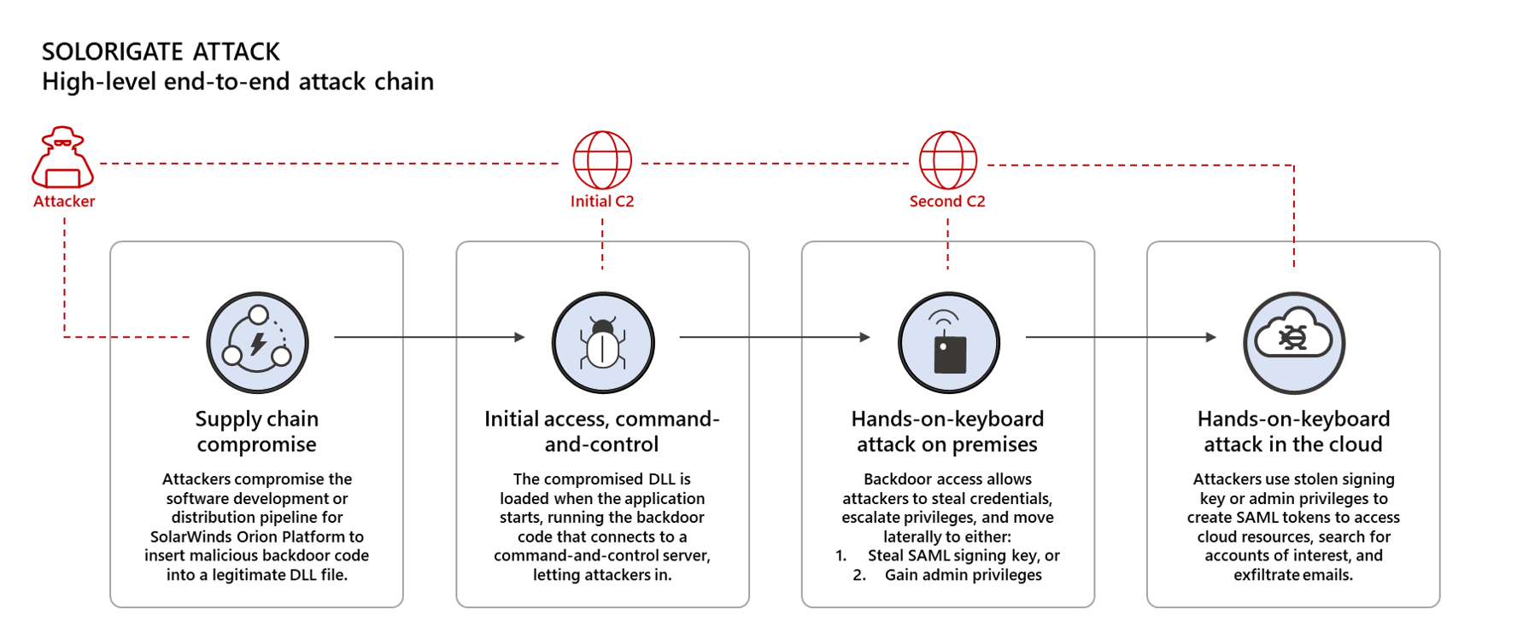
Supply chain attacks - Solorigate
High-level end-to-end attack chain (https://security.microsoft.com/threatanalytics3/2b74f636-146e-48dd-94f6-5cb5132467ca/overview)
Notes:
https://www.microsoft.com/security/blog/2021/01/14/increasing-resilience-against-solorigate-and-other-sophisticated-attacks-with-microsoft-defender/
https://security.microsoft.com/threatanalytics3/2b74f636-146e-48dd-94f6-5cb5132467ca/overview
https://techcommunity.microsoft.com/t5/azure-sentinel/solarwinds-post-compromise-hunting-with-azure-sentinel/ba-p/1995095

Slide 32
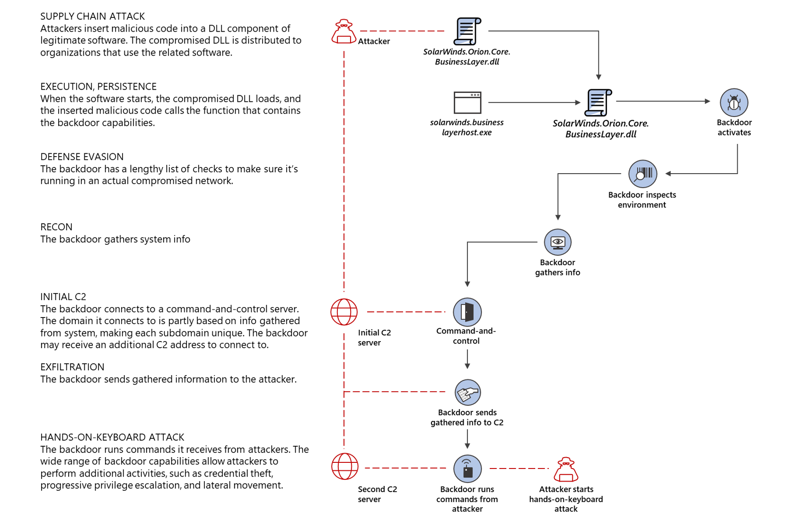
Supply chain attacks - Solorigate
High-level end-to-end attack chain (https://security.microsoft.com/threatanalytics3/2b74f636-146e-48dd-94f6-5cb5132467ca/overview)
Notes:
https://www.microsoft.com/security/blog/2021/01/14/increasing-resilience-against-solorigate-and-other-sophisticated-attacks-with-microsoft-defender/
https://security.microsoft.com/threatanalytics3/2b74f636-146e-48dd-94f6-5cb5132467ca/overview
https://techcommunity.microsoft.com/t5/azure-sentinel/solarwinds-post-compromise-hunting-with-azure-sentinel/ba-p/1995095
https://www.microsoft.com/security/blog/2020/12/18/analyzing-solorigate-the-compromised-dll-file-that-started-a-sophisticated-cyberattack-and-how-microsoft-defender-helps-protect/

Slide 33
Tech support scams
Tech support scams are an industry-wide issue where scammers use scare tactics to trick users into paying for unnecessary technical support services that supposedly fix contrived device, platform, or software problems.
Scammers might also initiate contact by displaying fake error messages on websites you visit, displaying support numbers and enticing you to call.
They can also put your browser on full screen and display pop-up messages that won't go away, essentially locking your browser.

Slide 34
Trojans
Trojans are a common type of malware which, unlike viruses, can’t spread on their own.
This means they either have to be downloaded manually or another malware needs to download and install them.
Trojans often use the same file names as real and legitimate apps.
It is easy to accidentally download a trojan thinking that it is a legitimate app.

Slide 35
Unwanted software
Unwanted software are programs that alter the Windows experience without your consent or control.
This can take the form of modified browsing experience, lack of control over downloads and installation, misleading messages, or unauthorized changes to Windows settings.
Some applications are software bundlers, which means that they are packed with other applications. As a result, other programs can be inadvertently installed when the original application is downloaded.

Slide 36
Potentially unwanted application (PUA)
PUAs are not considered malware
Advertising software
Torrent software
Cyptomining software
Bundling software
Marketing software
Evasion software
Poor industry reputation
Notes:
https://docs.microsoft.com/en-us/windows/security/threat-protection/intelligence/criteria

Slide 37
Worms
A worm is a type of malware that can copy itself and often spreads through a network by exploiting security vulnerabilities.
It can spread through email attachments, text messages, file-sharing programs, social networking sites, network shares, removable drives, and software vulnerabilities.
Jenxcus (also known as Dunihi), Gamarue (also known as Androm), and Bondat have consistently remained at the top of the list of malware that infects users running Microsoft software.
Notes:
Worms - Windows security | Microsoft Docs

Slide 38
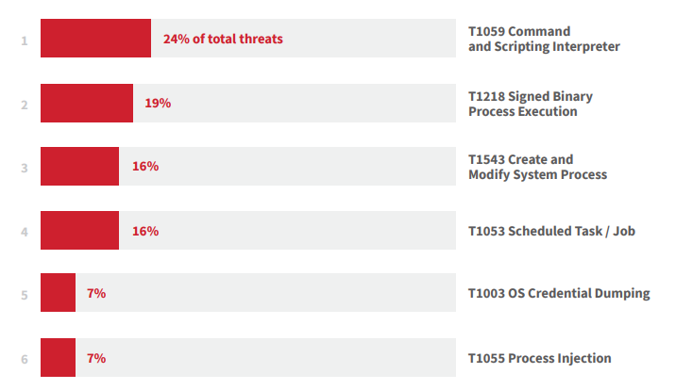
Top Threats 2021

Slide 39
T1059 – Command and Scripting Interpreter
PowerShell is an automation and configuration management framework which expands its capabilities beyond other common command-line and scripting languages. PowerShell is included by default in modern versions of Windows.
Adversaries use PowerShell to obfuscate commands in hopes of achieving any of the following:
Evading detection
Spawning additional processes
Downloading and executing remote code and binaries
Gathering information
Changing system configuration
Encoding or obfuscation more than any other variety of malicious or suspicious PowerShell. PowerShell’s flexibility along with its support for aliases, abbreviated cmdlets, argument names, and calling .NET methods offers attackers many ways to invoke Base64 and other encoding.
-e; -ec; -encodecommand; [System.Convert]::FromBase64String()

Slide 40
T1218 – Signed Binary Process Execution
Rundll32 is a native Windows process installed by default. It is a functionally necessary component of the Windows operating system that can’t be simply blocked or disabled.
This necessity and ubiquity makes Rundll32 an attractive target for adversaries.
Often leverage Rundll32 to load code from DLLs within world writable directories (such as Windows temp directory), a pattern of behavior that you might see from legitimate enterprise software as well as not-so-legit tools like Cobalt Strike.
Example 1 : Use Rundll32 to load the legitimate comsvcs.dll, which calls the MiniDump function, allowing adversaries to dump the memory of certain processes (like lsass.exe).
Example 2 : A legitimate function of Rundll32 that is used for a variety of reasons. Several threats (such as Qbot, Dridex, ,Egregor and Maze) can leverage it as a mechanism to bypass application controls.
Example 3 : Cobalt Strike leverages the StartW function to load DLLs from the command line.

Slide 41
T1543 – Create and Modify System Process
Windows services are imperative to the normal functions of the operating system.
They are common binaries that run in the background and are typically not cause for alarm when executed.
Since Windows services already exist on the system, an adversary who is able to modify or install a new service is less likely to draw attention to their activities than an adversary who installs and runs an unknown binary or spawns a command from a command or scripting interpreter.
A common pattern is the use of the Windows Service Control Manager Configuration Tool (sc.exe) to modify or create a service.
Example: Blue Mockingbird, an activity cluster that deploys Monero cryptocurrency-mining payloads and leverages Windows services for persistence.

Slide 42
T1053 – Scheduled Task / Job
Adversaries use scheduled tasks to accomplish two primary objectives, maintaining access and executing processes in a specific user context. Typically, one is with elevated privileges.
As a wide variety of legitimate software uses scheduled tasks for an even wider variety of legitimate reasons, malicious use often blends in with innocuous use.
Scheduled tasks are a functionally necessary component of the Windows operating system that can’t just be turned off or blocked.
Most attacks include the /Create flag, which makes sense for adversaries wanting to establish persistence.

Slide 43
T1003 – OS Credential Dumping
Attackers attempt to dump credentials to obtain account login and credential material, normally in the form of a hash or a clear text password, from the operating system and software.
Credentials can then be used to perform Lateral Movement and access restricted information.
Example : The Local Security Authority Subsystem Service (LSASS) is commonly used by attackers looking to steal sensitive credentials, with a little help from administrative tools such as ProcDump or tools like Mimikatz.
Upon starting up, LSASS contains valuable authentication data such as:
Encrypted passwords
NT hashes
LM hashes
Kerberos tickets

Slide 44
Question…
How would you mitigate T1059?
Notes:
You can utilize any of the following mitigations:
M1049 Antivirus/Antimalware Anti-virus can be used to automatically quarantine suspicious files.
M1045 Code Signing Where possible, only permit execution of signed scripts.
M1042 Disable or Remove Feature or Program Disable or remove any unnecessary or unused shells or interpreters.
M1038 Execution Prevention Use application control where appropriate.
M1026 Privileged Account Management When PowerShell is necessary, restrict PowerShell execution policy to administrators. Be aware that there are methods of bypassing the PowerShell execution policy, depending on environment configuration.^{[37]}
M1021 Restrict Web-Based Content Script blocking extensions can help prevent the execution of scripts and HTA files that may commonly be used during the exploitation process. For malicious code served up through ads, adblockers can help prevent that code from executing in the first place.

Slide 45
Catching Attacks

Slide 46
Catching Attacks
Microsoft Defender ATP automatically covers the end-to-end threat lifecycle from protection and detection to investigation and response.
Microsoft Defender ATP’s automated investigation and remediation leverages state of the art AI technology to resolve incidents, investigate alerts, apply artificial intelligence to determine whether a threat is real, and determine what action to take, going from alert to remediation in minutes at scale.
Similar to a human analyst, Microsoft Defender ATP continuously monitors the alert queue.
Once an alert is received, we will briefly analyze its risk and adjust the machine(s) risk level accordingly, which will automatically enforce Conditional Access to contain the threat.
As an alert contains detection information and related data, Microsoft Defender ATP will analyze this information and generate context aware questions
Notes:
Microsoft Defender ATP Automation

Slide 47
Context Aware Questions
Where was the file created?
Who created the file?
What else was created with this file?
Where did this file come from?
Where else can I see this file in your organization?
Where else can I see this file worldwide?
When was the file created?
What are the file permissions?
Is the file digital signed?
Was it part of an install process?
Is it similar to any other file?
Have we seen it before?
Was the file executed?
Notes:
Microsoft Defender ATP Automation

Slide 48
Lead to More Questions…
When was this process first initiated?
Whats the full process execution tree?
What other files did this process create?
What other modules did this process load?
Where did the process communicate to?
Did it change any persistency method?
Where else have I seen this process in your organization?
What is the process image file?
Notes:
Microsoft Defender ATP Automation

Slide 49
When all questions are answered…
Now with all those answers, we have finalized our investigation process and have all the context we need in order to build the right response package.
A response package will contain what is needed to safely remove the threat. For example:
For the C2 communication we will go ahead and block connection to it to make sure another variant of this threat will not be able to communicate with this C2.
For all the persistency method, we need to go back to our investigation data, and based on the outcome, securely remove them etc.
The response contains two main parts: real-time remediation (killing a process, quarantine a file, terminating a connection…) and future prevention (blocking IP, adding file to a blocklist) to avoid any further reoccurrence.
Now that the threat was remediated and your machines self-healed, we will auto-resolve the alerts for you and safely remove it from your “to-do-list”.
Notes:
Microsoft Defender ATP Automation

Slide 50
Attack Examples
Nobelium (GoldMax, GoldFinger, Sibot, Teardrop, Sunspot, Raindrop) - https://www.microsoft.com/security/blog/2021/05/28/breaking-down-nobeliums-latest-early-stage-toolset/
Phishing - Tackling phishing with signal-sharing and machine learning - Microsoft Security
Solorigate - https://www.microsoft.com/security/blog/2021/01/14/increasing-resilience-against-solorigate-and-other-sophisticated-attacks-with-microsoft-defender/
Solarwinds #2 - https://techcommunity.microsoft.com/t5/azure-sentinel/solarwinds-post-compromise-hunting-with-azure-sentinel/ba-p/1995095
APT29 - MITRE ATT&CK APT 29 evaluation proves Microsoft Threat Protection provides deeper end to end view of advanced threats - Microsoft Security
Engenuity - https://www.microsoft.com/security/blog/2021/04/21/mitre-engenuity-attck-evaluation-proves-microsoft-defender-for-endpoint-stops-advanced-attacks-across-platforms/?_lrsc=70c400f5-d07f-42f0-96d6-42e602a3fa29
BISMUTH - https://www.microsoft.com/security/blog/2020/11/30/threat-actor-leverages-coin-miner-techniques-to-stay-under-the-radar-heres-how-to-spot-them/
Notes:
Tackling phishing with signal-sharing and machine learning - Microsoft Security
https://www.microsoft.com/security/blog/2021/01/14/increasing-resilience-against-solorigate-and-other-sophisticated-attacks-with-microsoft-defender/
MITRE ATT&CK APT 29 evaluation proves Microsoft Threat Protection provides deeper end to end view of advanced threats - Microsoft Security
https://www.microsoft.com/security/blog/2021/04/21/mitre-engenuity-attck-evaluation-proves-microsoft-defender-for-endpoint-stops-advanced-attacks-across-platforms/?_lrsc=70c400f5-d07f-42f0-96d6-42e602a3fa29

Slide 51
MITRE Engenuity (2020)
The 2020 ATT&CK Evaluations concentrated on advanced threat actors known to the industry as FIN7 and Carbanak (also called Carbon Spider).
The evaluation included two new benchmarks (detection and protection) and cooresponding simulations of more than 174 steps across the attack chain, affecting both Windows client endpoints, servers, and, for the first time, Linux devices.
To fully execute the end-to-end detection and protection simulations of Carbanak and FIN7, MITRE Engenuity required participants to provide two different environments.
Detection environment: MITRE Engenuity asked participants to turn off all proactive protection and blocking capabilities.
Protection environment: All proactive protection and blocking capabilities are turned on.
Microsoft Defender for Endpoint blocked the attack at the earliest stage, providing containment in real-time. Defender for Endpoint quickly identified the suspicious activity and incriminated it as malicious.
Microsoft 365 Defender dramatically reduced alert noise from over 1,000 alerts down to just two incidents.
All protection and detection value presented by Microsoft Defender for Endpoint is the result of fully automated, AI-driven advanced algorithms meant to protect organizations from advanced attacks with no additional services needed.
Notes:
https://www.microsoft.com/security/blog/2021/04/21/mitre-engenuity-attck-evaluation-proves-microsoft-defender-for-endpoint-stops-advanced-attacks-across-platforms/?_lrsc=70c400f5-d07f-42f0-96d6-42e602a3fa29

Slide 52
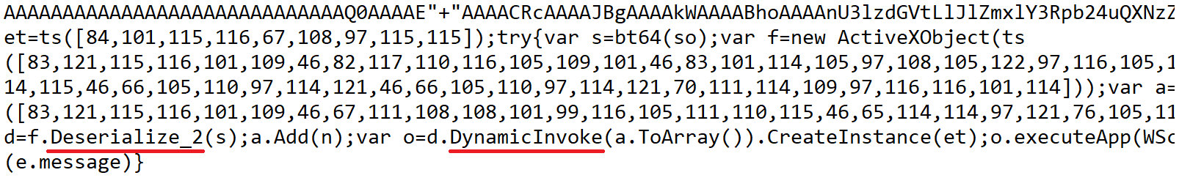
Fileless (Sharpshooter technique)
The Sharpshooter technique allows an attacker to use a script to execute a .NET binary directly from memory without ever needing to reside on the disk.
This technique provides a framework that can enable attackers to easily repackage the same binary payload within a script.
The detection algorithm leverages AMSI support in scripting engines and targets a generic malicious behavior (a fingerprint of the malicious fileless technique).
Notes:
https://www.microsoft.com/security/blog/2018/09/27/out-of-sight-but-not-invisible-defeating-fileless-malware-with-behavior-monitoring-amsi-and-next-gen-av/

Slide 53
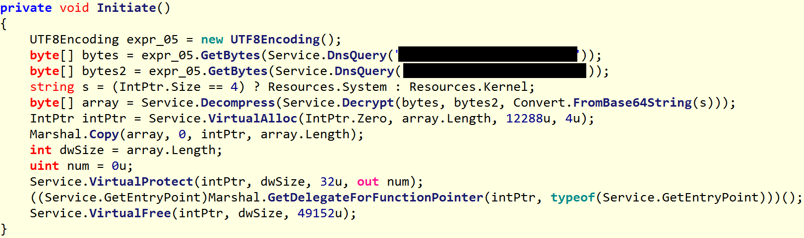
Fileless (Sharpshooter technique)
The detection algorithm leverages AMSI support in scripting engines and targets a generic malicious behavior (a fingerprint of the malicious fileless technique).
Generically detecting the Sharpshooter technique allowed us to discover a particularly sophisticated and interesting attack. Windows Defender ATP’s endpoint and detection response capabilities caught a VBScript file that used the Sharpshooter technique.
The malware payload downloads data from its command-and-control (C&C) server via the TXT records of DNS queries. In particular, it downloads the initialization vector and decryption key necessary to decode the core of the malware.

Slide 54
Fileless (GandCrab + Dofoil)
Even if malware can run without the use of a physical file, it does need to reside in memory in order to operate and is therefore detectable by means of memory scanning.
The payload DLL is encoded in a string, then decoded and run dynamically via PowerShell. The DLL itself is never dropped on the disk.
Using memory scanning, Microsoft Defender can scan the memory of running processes and detect known patterns of the ransomware run from the stealthy DLL.
Memory scanning, in conjunction with behavior monitoring and other dynamic defenses, helped Microsoft Defender to disrupt a massive Dofoil campaign.
Dofoil, a known nasty downloader, uses some sophisticated techniques to evade detection, including process hollowing, which allows the malware to execute in the context of a legitimate process (e.g., explorer.exe).

Slide 55
BISMUTH
Cryptocurrency miners are typically associated with cybercriminal operations, not sophisticated nation state actor activity.
They are not the most sophisticated type of threats, which also means that they are not among the most critical security issues that defenders address with urgency.
Recent campaigns from the nation-state actor BISMUTH take advantage of the low-priority alerts coin miners cause to try and fly under the radar and establish persistence.
Notes:
https://www.microsoft.com/security/blog/2020/11/30/threat-actor-leverages-coin-miner-techniques-to-stay-under-the-radar-heres-how-to-spot-them/

Slide 56
BISMUTH (Analysis)
Initial Access - by sending specially crafted malicious emails from a Gmail account that appears to have been made specifically for this campaign
Discovery - Once established as a scheduled task, the co-opted Word 2007 process dropped and loaded a scanning tool popular among attackers, NbtScan.exe. BISMUTH then immediately used the scanning tool to scan an IP address range within the organization.
Lateral Movement - They dropped the tool onto different devices using SMB remote file copy, using file names related to popular Japanese video game characters and a seemingly random word. dumped credentials from the Security Account Manager (SAM) database using the Empire PowerDump command and then quickly deleted PowerShell event logs to erase records generated by Script Block Logging.
Credential Theft – The group used DebugView and the malicious DLL in a fairly unexpected fashion to launch Base64-encoded Mimikatz commands using one of several Windows processes: makecab.exe, systray.exe, w32tm.exe, bootcfg.exe, diskperf.exe, esentutl.exe, and typeperf.exe.
Coin Miners - BISMUTH deployed coin miners during these attacks. To do this, they first dropped a .dat file and loaded the file using rundll32.exe, which in turn downloaded a copy of the 7-zip tool named 7za.exe and a ZIP file. They then used 7-Zip to extract a Monero coin miner from the ZIP file and registered the miner as a service named after a common Virtual Machine process.
Notes:
https://www.microsoft.com/security/blog/2020/11/30/threat-actor-leverages-coin-miner-techniques-to-stay-under-the-radar-heres-how-to-spot-them/

Slide 57
NOBELIUM
NOBELIUM is an actor that operates with rapid operational tempo, often leveraging temporary infrastructure, payloads, and methods to obfuscate their activities.
It is suspected that NOBELIUM can draw from significant operational resources that are often showcased in their periodic campaigns.
Since December 2020, the security community has identified a growing collection of payloads attributed to the actor, including the GoldMax, GoldFinder, and Sibot malware identified by Microsoft, as well as TEARDROP (FireEye), SUNSPOT (CrowdStrike), Raindrop (Symantec) and, most recently, FLIPFLOP (Volexity).
Despite growing community visibility since the exposure of the SolarWinds attack in late 2020, NOBELIUM has continued to target government and diplomatic entities across the globe.
Notes:
https://www.microsoft.com/security/blog/2021/05/28/breaking-down-nobeliums-latest-early-stage-toolset/

Slide 58
NOBELIUM (EnvyScout)
EnvyScout, can be best described as a malicious dropper capable of de-obfuscating and writing a malicious ISO file to disk. EnvyScout is chiefly delivered to targets of NOBELIUM by way of an attachment to spear-phishing emails.
Component #1: Tracking and credential-harvesting URLs
Component #2: FileSaver JavaScript helper code
Component #3: Obfuscated ISO file
Component #4: De-obfuscator and dropper script
The sophisticated NOBELIUM attack requires a comprehensive incident response to identify, investigate, and respond.
Notes:
https://www.microsoft.com/security/blog/2021/05/28/breaking-down-nobeliums-latest-early-stage-toolset/

Slide 59
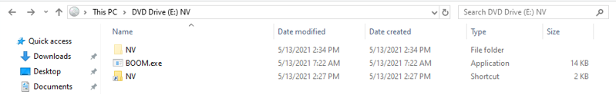
NOBELIUM (EnvyScout)
When a target user opens NV.img (dropped by EnvyScout) by double-clicking it, the default behavior on Windows 10 is to mount the ISO image at the next available drive letter. Windows Explorer subsequently displays the contents of the mounted ISO in a window, similar to what users see when they open folders or compressed archives.
BOOM.exe, tracked by Microsoft as “BoomBox”, can be best described as a malicious downloader. The downloader is responsible for downloading and executing the next-stage components of the infection. These components are downloaded from Dropbox (using a hardcoded Dropbox Bearer/Access token).
After successfully downloading the encrypted file from Dropbox, BoomBox discards the first 10 bytes from the header and 7 bytes from the footer of the encrypted file, and then AES-decrypts the rest of the file using the hardcoded encryption key “123do3y4r378o5t34onf7t3o573tfo73” and IV value “1233t04p7jn3n4rg”.
Notes:
https://www.microsoft.com/security/blog/2021/05/28/breaking-down-nobeliums-latest-early-stage-toolset/

Slide 60
NOBELIUM (BoomBox)
BoomBox writes the decrypted file to the file system at %AppData%\Microsoft\NativeCache\NativeCacheSvc.dll. It then establishes persistence for NativeCacheSvc.dll by creating a Run registry value named MicroNativeCacheSvc
It writes the decrypted file at %AppData%\SystemCertificates\CertPKIProvider.dll and proceeds to execute the previously dropped file NativeCacheSvc.dll using the same rundll32.exe command as above.
BoomBox executes an LDAP query to gather data such as distinguished name, SAM account name, email, and display name of all domain users via the filter (&(objectClass=user)(objectCategory=person)).
The export function issues an HTTP(s) GET request to a legitimate but compromised WordPress site holescontracting[.]com.
The download-decode-execute process is repeated indefinitely, approximately every hour, until the DLL is unloaded from memory. VaporRage can execute any compatible shellcode provided by its C2 server, including a Cobalt Strike stage shellcode.
Notes:
https://www.microsoft.com/security/blog/2021/05/28/breaking-down-nobeliums-latest-early-stage-toolset/

Slide 61
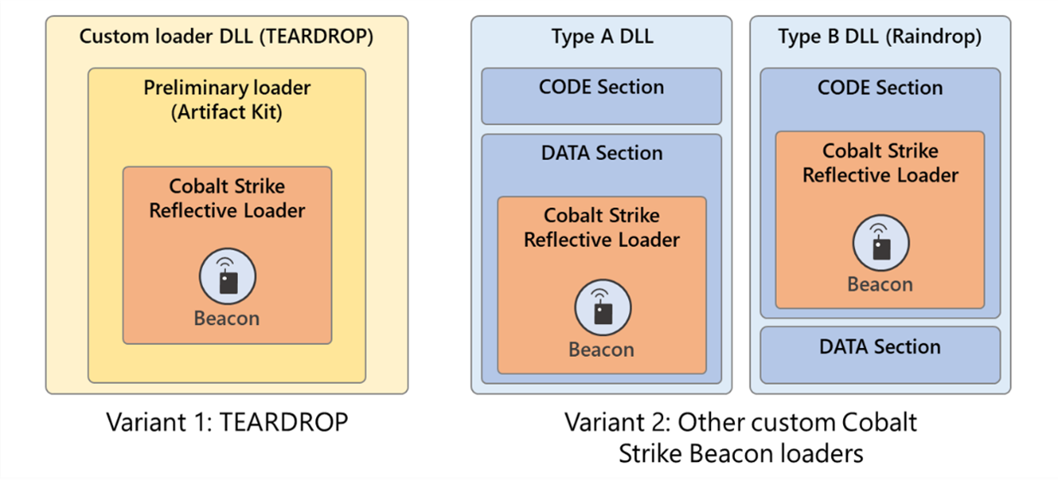
NOBELIUM (NativeZone)
NOBELIUM has used multiple custom Cobalt Strike Beacon loaders (likely generated using custom Artifact Kit templates) to enable their malicious activities. These include TEARDROP, Raindrop, and other custom loaders.
The new NativeZone loaders can be grouped into two variants:
Variant #1: These loaders embed an encoded/encrypted Cobalt Strike Beacon stage shellcode
Variant #2: These loaders load an encoded/encrypted Cobalt Strike Beacon stage shellcode from another accompanying file (e.g., an RTF file).
Notes:
https://www.microsoft.com/security/blog/2021/05/28/breaking-down-nobeliums-latest-early-stage-toolset/

Slide 62
Microsoft Defender - Attack Benefits
APT29 Attack Example - 57 MITRE ATT&CK techniques replicated during simulation.
MTP consolidated the alerts into just two incidents, dramatically simplifying the volume of triage and investigation work needed.
This gives the SOC the ability to prioritize and address the incident as a whole and enables streamlined triage, investigation, and automated response process against the complete attack.
Built in automation that identifies the complex links between attacker activities and builds correlations across domains that piece together the attack story with all of its related alerts, telemetry, evidence and affected assets into coherent incidents.
These comprehensive incidents are then prioritized and escalated to the SOC.
Notes:
MITRE ATT&CK APT 29 evaluation proves Microsoft Threat Protection provides deeper end to end view of advanced threats - Microsoft Security
Microsoft Threat Protection leads in real-world detection in MITRE ATT&CK evaluation - Microsoft Security

Slide 63
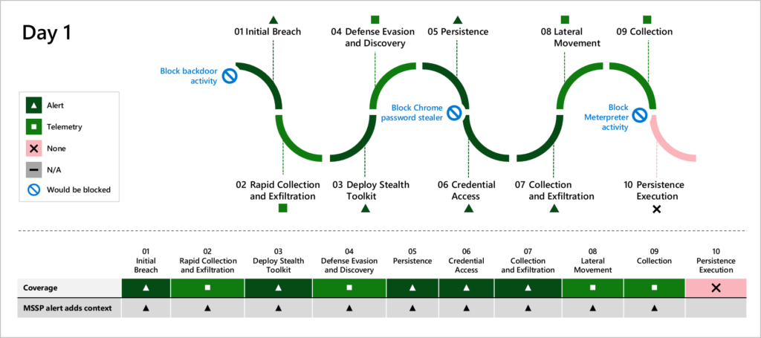
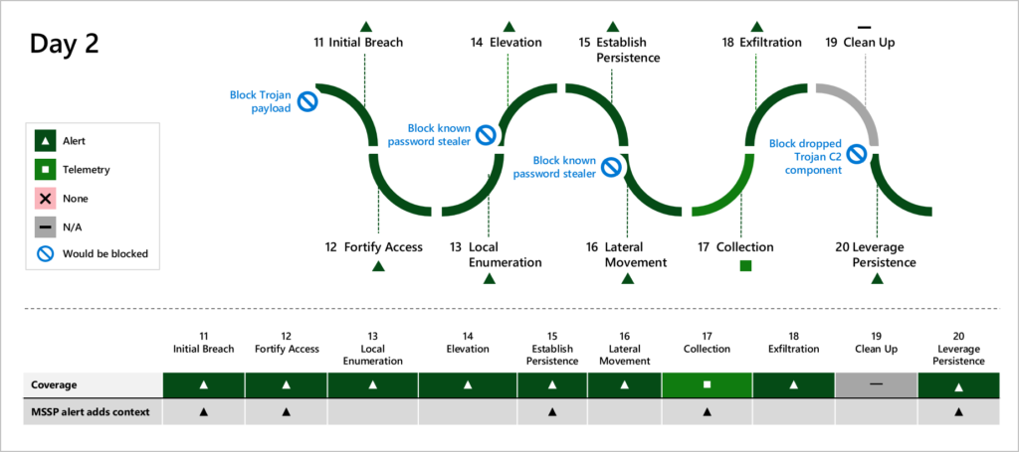
Microsoft Defender - Attack Benefits
APT29 Attack Example
Defender missed the Persistence Execution. Bug was fixed, and the persistence attempt was caught.
Notes:
MITRE ATT&CK APT 29 evaluation proves Microsoft Threat Protection provides deeper end to end view of advanced threats - Microsoft Security
Microsoft Threat Protection leads in real-world detection in MITRE ATT&CK evaluation - Microsoft Security

Slide 64
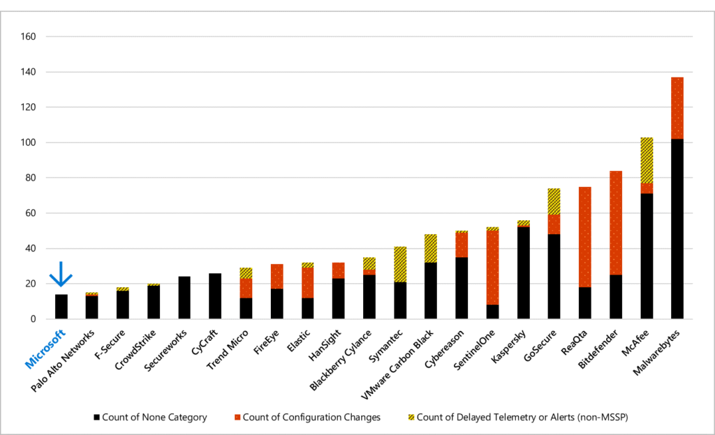
Microsoft Defender vs Other Providers
APT29 Attack
Microsoft is one of only three vendors that made no modifications or had any delays during the test.

Slide 65
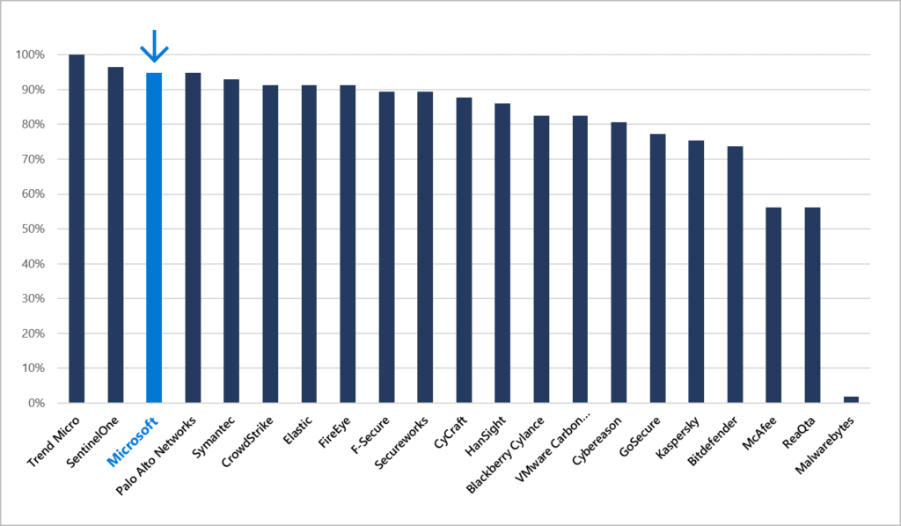
Microsoft Defender vs Other Providers
APT29 Attack
Coverage across all attack techniques in the evaluation.
Microsoft’s coverage shows top performance at 95 percent of the techniques covered

Slide 66

Full Group Activity: Attack Patterns
Objective: As a result of participating in this activity, you will better be able to answer questions about the product(s).
What you will be doing: The facilitator will be posting questions to the entire group using an interactive tool called Mentimeter. The answers you post using Mentimeter will then drive the discussion.
Total Activity Time: 30 minutes

Slide 67

Mentimeter Poll
Scan QR Code
or Go to www.menti.com and use code
1183 9575
Notes:
https://www.menti.com/9r2wwujwag

Slide 68
Breakout Activity: Attack Patterns
As a result of participating in this activity, you will better be able to Understand Attack Patterns
OUTCOMES
ACTIVITY
60 minutes
Learning Adviser
Table Group Channel
As a team review WWI requirements provided in student guide
Open the whiteboard and as a team answer the provided challenge questions.
The questions are pre-loaded into the whiteboard.
Welcome | Keynote | Demo Walkthrough | Break | Attack Patterns + Catching Attacks | Activity: Attack Patterns | Break | Lab: Attack Simulation | Long Break | Windows Defender, Attack Analysis, Threats | Restoring Systems | Activity: Restoring Systems | Lab: Restoring Systems | Closing

Slide 69
Build Hands-on Lab: Attack Simulation
As a result of participating in this lab, you will be better able to perform some infrastructure attacks
OUTCOMES
ACTIVITY
60 minutes
Independent
Table Group Channel & CloudLabs Environment
Independently review and complete Exercises 1-4 in the Lab 1 Guide.
Login to your CloudLabs environment and work through a set of tasks you would typically follow in work associated with ingesting and integrating your customer’s data.
The Lab Guide is available in the ‘Files’ tab of the General channel. Engage your Table Group call for support and troubleshooting.
Welcome | Keynote | Demo Walkthrough | Break | Attack Patterns + Catching Attacks | Activity: Attack Patterns | Break | Lab: Attack Simulation | Long Break | Windows Defender, Attack Analysis, Threats | Restoring Systems | Activity: Restoring Systems | Lab: Restoring Systems | Closing

Slide 70
Thank You slide
Long Break (60 mins)

Slide 71
Welcome Back!
Kick-Off | 8:00-8:05 | Welcome | Main Call
 | 8:05-8:30 | Attack Patterns + Analysis
 | 8:30-8:45 | Demo Walkthrough
Ingest | 8:45-9:00 | Break
 | 9:00-10:00 | Attack Patterns + Catching Attacks
 | 10:00-11:00 | Activity: Attack Patterns | Table Group Call
 | 11:00-12:00 | Build Hands-on: Attack Simulation
 | 12:00-1:00 | Long Break | Table Group Call
Transform | 1:00-2:00 | Windows Defender, Attack Analysis, Emerging Threats | Main Call
 | 2:00-2:30 | Restoring Systems
 | 2:30-2:45 | Break
 | 2:45-3:15 | Activity: Restoring Systems
 | 3:15-4:00 | Build Hands-on: Restoring Systems | Table Group Call
 | 4:00-4:15 | Closing | Main Call
Presentation/
Whole Group
Lab
Activity/ Discussion/ Group Work
Announcements

Slide 72
Windows Defender + Microsoft Defender

Slide 73
System Guard
Windows Defender System Guard helps defend against firmware attacks by providing guarantees for secure boot through hardware-backed security features like hypervisor-level attestation and Secure Launch, also known as Dynamic Root of Trust (DRTM), which are enabled by default in Secured-core PCs.

Slide 74
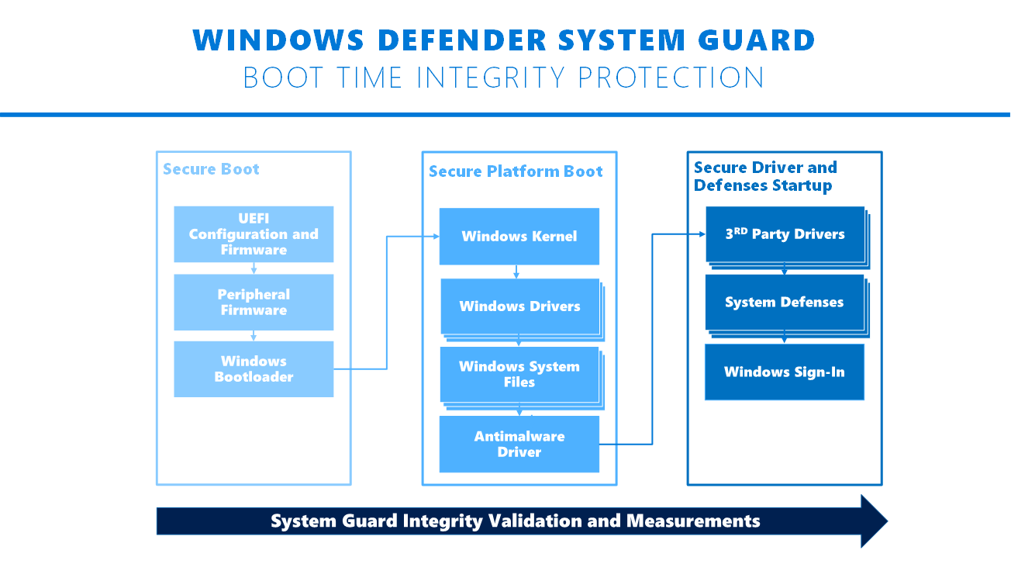
System Guard

Slide 75
Secure Boot
Secure Boot is a security standard developed by members of the PC industry to help make sure that your PC boots using only software that is trusted by the PC manufacturer.
When the PC starts, the firmware checks the signature of each piece of boot software, including firmware drivers (Option ROMs) and the operating system. If the signatures are good, the PC boots, and the firmware gives control to the operating system.
Secure Boot requires a PC that meets the UEFI Specifications Version 2.3.1, Errata C or higher.
UEFI is a replacement for the older BIOS firmware interface and the Extensible Firmware Interface (EFI) 1.10 specifications.
Secure Boot does not require a Trusted Platform Module (TPM).
Notes:
Secure Boot Overview | Microsoft Docs

Slide 76
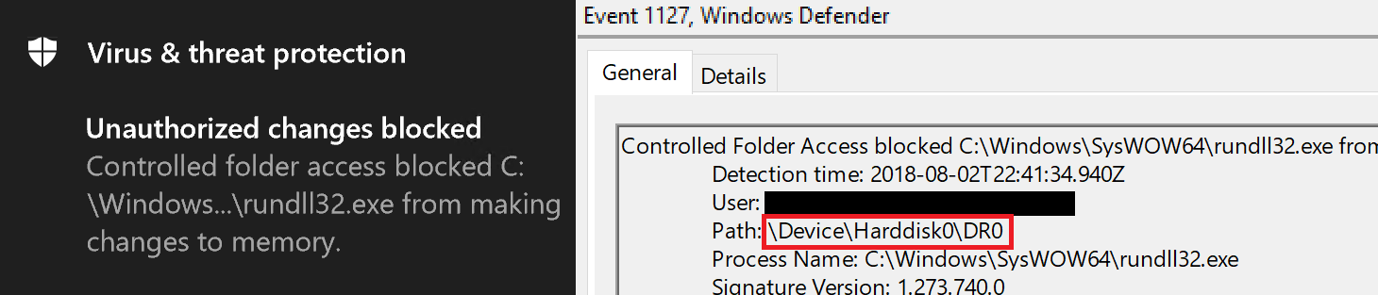
Controlled Folder Access
Microsoft Defender does not allow write operations to the boot sector, thus closing a dangerous fileless attack vector used by Petya, BadRabbit, and bootkits in general.
Boot infection techniques can be suitable for fileless threats because they can allow malware to reside outside of the file system and gain control of the machine before the operating system is loaded.
The use of rootkit techniques, like in the defunct Alureon malware (also known as TDSS or TDL-4), can then render the malware invisible and extremely difficult to detect and remove.
With Controlled folder access, which is part of Microsoft Defender attack surface reduction capabilities, this entire class of infection technique has become a thing of the past.

Slide 77
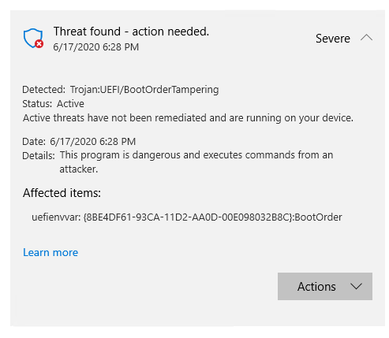
Unified Extensible Firmware Interface (UEFI) scanner
The UEFI scanner is a new component of the built-in antivirus solution on Windows 10 and gives Microsoft Defender the unique ability to scan inside of the firmware filesystem and perform security assessment.
It integrates insights from our partner chipset manufacturers and further expands the comprehensive endpoint protection provided by Microsoft Defender.
To detect threats, it performs dynamic analysis using multiple new solution components that include:
UEFI anti-rootkit, which reaches the firmware through Serial Peripheral Interface (SPI)
Full filesystem scanner, which analyzes content inside the firmware
Detection engine, which identifies exploits and malicious behaviors
Notes:
https://www.microsoft.com/security/blog/2020/06/17/uefi-scanner-brings-microsoft-defender-atp-protection-to-a-new-level/

Slide 78
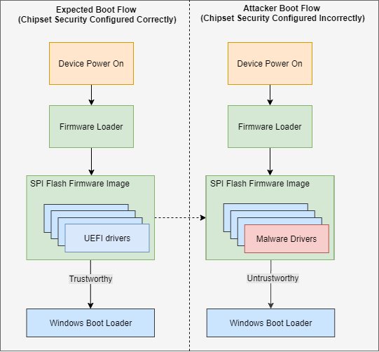
UEFI Architecture
For devices that are configured correctly, the boot path from power-on to OS initialization is reliable.
If secure boot is disabled or if the motherboard chipset is misconfigured, attackers can change the contents of UEFI drivers that are unsigned or tampered with in the firmware.
This could allow attackers to take over control of devices and give them the capability to deprivilege the operating system kernel or antivirus to reconfigure the security of the firmware.
Notes:
https://www.microsoft.com/security/blog/2020/06/17/uefi-scanner-brings-microsoft-defender-atp-protection-to-a-new-level/

Slide 79
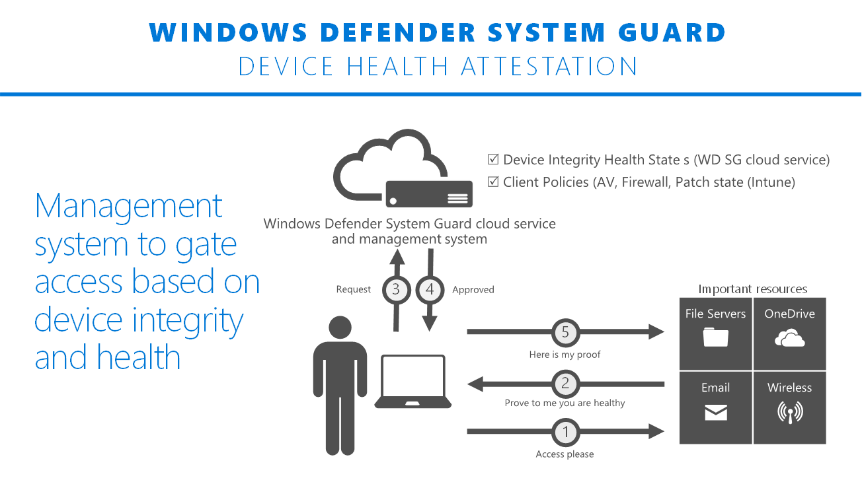
Device Health

Slide 80
Trusted Platform Module (TPM)
Trusted Platform Module (TPM) technology is designed to provide hardware-based, security-related functions. A TPM chip is a secure crypto-processor that helps you with actions such as generating, storing, and limiting the use of cryptographic keys.
As Windows 10 boots, a series of integrity measurements are taken by Windows Defender System Guard using the device’s Trusted Platform Module 2.0 (TPM).
This process and data are hardware isolated away from Windows to help ensure that the measurement data is not subject to the type of tampering that could happen if the platform was compromised.
After the system boots, Windows Defender System Guard signs and seals these measurements using the TPM, and, upon request a management system, like Intune or System Center Configuration Manager, can acquire them for remote analysis
Notes:
Trusted Platform Module (Windows 10) - Microsoft 365 Security | Microsoft Docs

Slide 81
Question…
What is now required hardware for Windows 11?
Notes:
In order to be certified, the device must include a TPM 2.0 chip.
https://www.microsoft.com/security/blog/2021/06/25/windows-11-enables-security-by-design-from-the-chip-to-the-cloud/

Slide 82
Attack Analysis

Slide 83
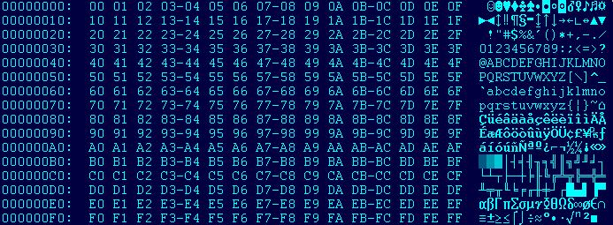
Attack Analysis (Traditional)
Security Response teams would typically evaluate 20+ files per day
Output from several tools (IDA, Resource Hacker, PEID, etc) would be combined to provide a clear picture
A faster approach / common technic is “Extended ASCII Analysis”
Visual cues / patterns in the text converted binary provide information on what the binary is / does

Slide 84

High vs Low Entropy
High entropy is data that is uniformly random vs low
Tend to determine Custom Packer vs Commercial Packer
Custom packer used to avoid antivirus (low entropy)
High Entropy indicates compressed data, well-encrypted data, random data, constants used in cryptographic calculations
Perfect entropy means each byte will occur once every 256 bytes (.39% of the time)
Common file types use compression (jpeg, gif, png, zip, rar, tar)
Using a Krypto Analyzer, crypto constants can be found and if known, skipped

Slide 85
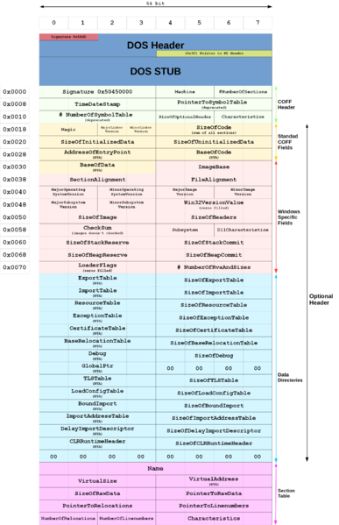
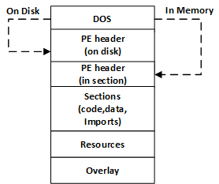
Portable Executable (PE) Files
Portable Executiable files are .exe and .dll files
Contain more than just code
text .rdata .data .rsrc .reloc
Appended Signature at end of file

Slide 86

X86 vs x64 vs MSIL
X86 characters maps fairly consistently with opcodes
In X86, 0x00 and 0xFF most common and tend to represent offsets (produce visible gaps in the code)
In X64 the ‘H’ character is more visible
In MSIL code, 25% of bytes are 0x00 (will show many gaps)

Slide 87
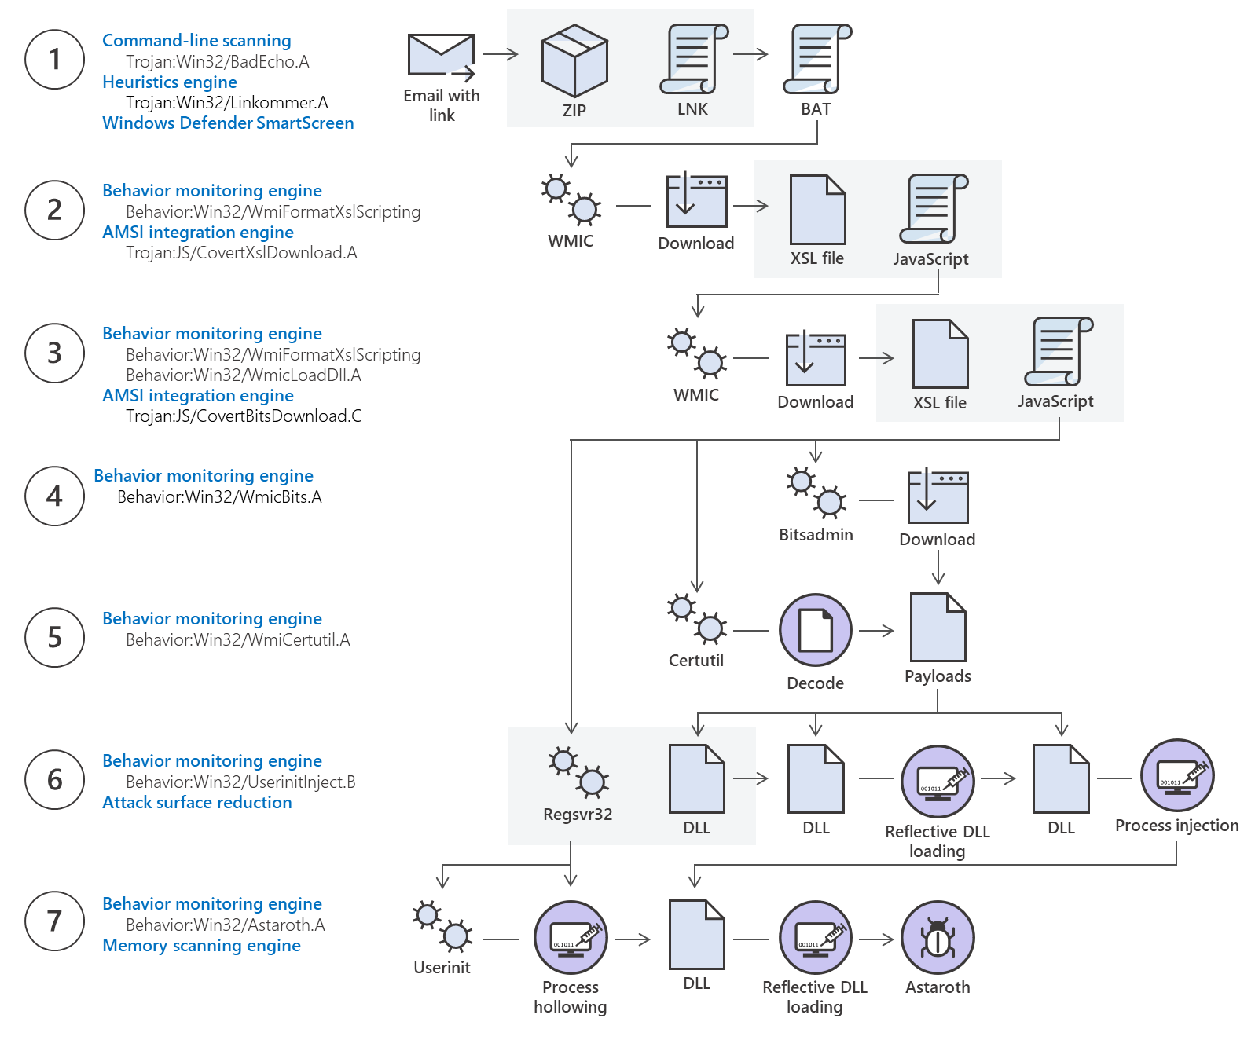
Attack Analysis (Windows)
Process Injection
Rundll32.exe
LSASS
Persistence via Scheduled Task
Keylogging
Brute force login
Sticky Keys
Remote service registration
PowerShell

Slide 88
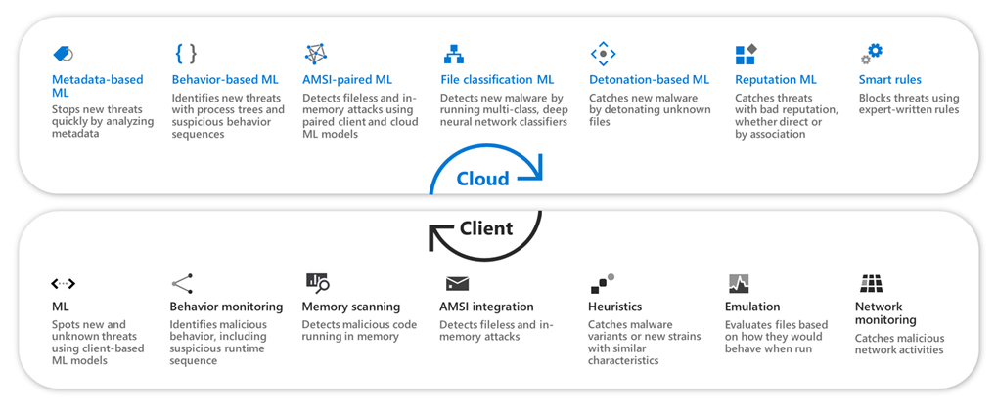
Attack Analysis (Machine Learning)
Rather than use human analysis, it is much faster to implement the previous techniques in a machine learning model - Microsoft Defender!
The value of machine learning is it works really well on zero-day threats.

Slide 89
Windows Antimalware Scan Interface (AMSI)
Interface standard that allows your applications and services to integrate with any antimalware product that's present on a machine.
AMSI is designed in particular to combat "fileless malware".
AMSI is agnostic of antimalware vendor; it's designed to allow for the most common malware scanning and protection techniques provided by today's antimalware products that can be integrated into applications.
Win32 API and COM interface provided.
It supports a calling structure allowing for file and memory or stream scanning, content source URL/IP reputation checks, and other techniques.
Notes:
https://docs.microsoft.com/en-us/windows/win32/amsi/antimalware-scan-interface-portal
https://docs.microsoft.com/en-us/windows/win32/amsi/dev-audience
https://docs.microsoft.com/en-us/windows/win32/amsi/antimalware-scan-interface-reference

Slide 90
AMSI Integration
The AMSI feature is integrated into these components of Windows 10.
User Account Control, or UAC (elevation of EXE, COM, MSI, or ActiveX installation)
PowerShell (scripts, interactive use, and dynamic code evaluation)
Windows Script Host (wscript.exe and cscript.exe)
JavaScript and VBScript
Office VBA macros
Each component will pass on the final target de-obfuscated code to AMSI, and then to the antivirus solution
Notes:
https://docs.microsoft.com/en-us/windows/win32/amsi/antimalware-scan-interface-portal

Slide 91
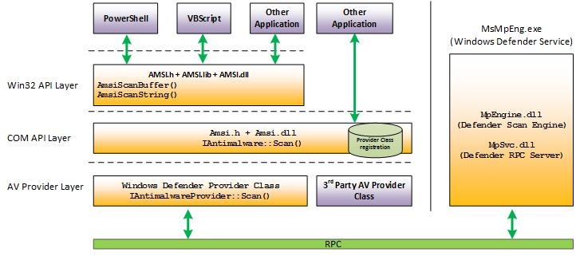
AMSI Architecture
Notes:
https://docs.microsoft.com/en-us/windows/win32/amsi/antimalware-scan-interface-portal

Slide 92
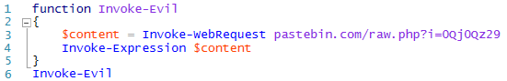
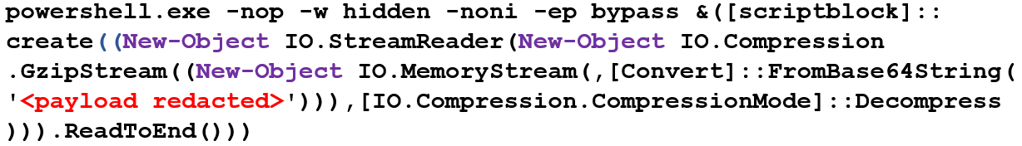
AMSI Integration (PowerShell)
Notes:
https://docs.microsoft.com/en-us/windows/win32/amsi/antimalware-scan-interface-portal

Slide 93
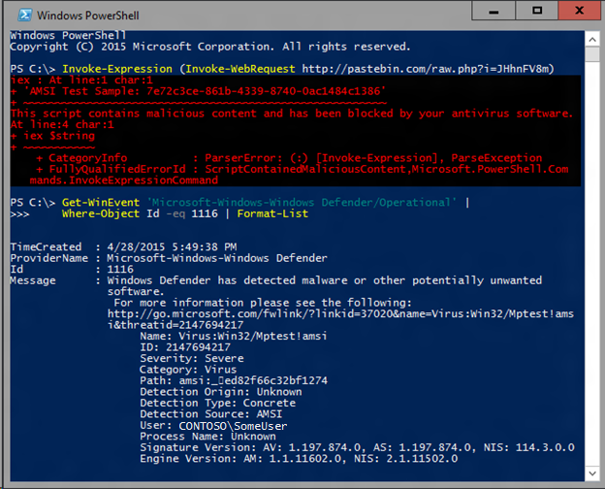
AMSI Integration (PowerShell)
Notes:
https://docs.microsoft.com/en-us/windows/win32/amsi/antimalware-scan-interface-portal

Slide 94
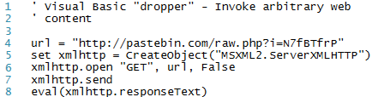
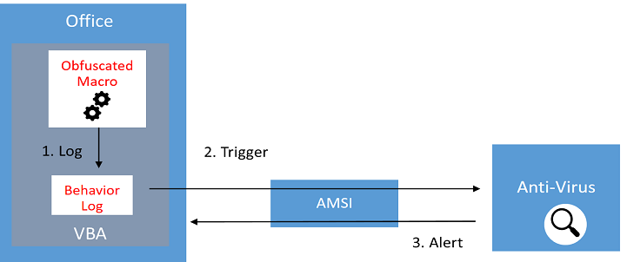
AMSI Integration (JavaScript/VBA)
Notes:
https://docs.microsoft.com/en-us/windows/win32/amsi/antimalware-scan-interface-portal

Slide 95
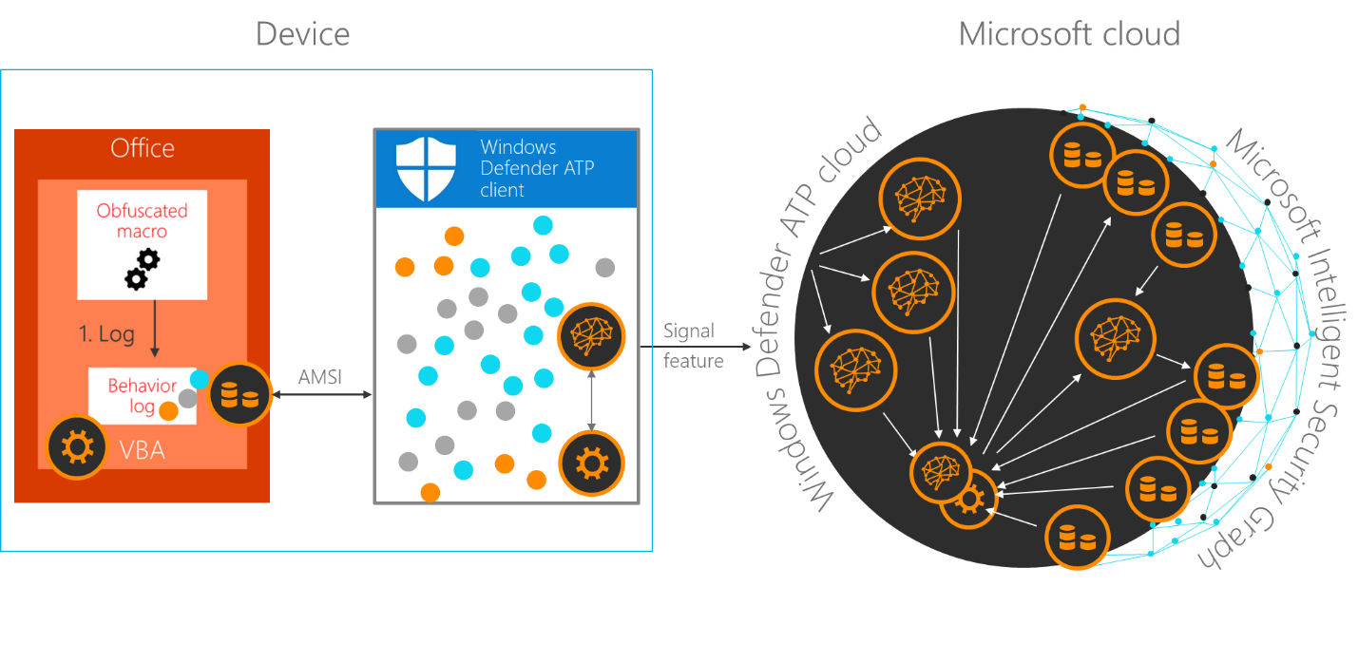
AMSI Integration (Office)

Slide 96
AMSI Integration (Office)
In its default configuration, macros are scanned at runtime via AMSI except in the following scenarios:
Documents opened while macro security settings are set to “Enable All Macros”
Documents opened from trusted locations
Documents that are trusted documents
Documents that contain VBA that is digitally signed by a trusted publisher
Notes:
https://www.microsoft.com/security/blog/2018/09/12/office-vba-amsi-parting-the-veil-on-malicious-macros/

Slide 97
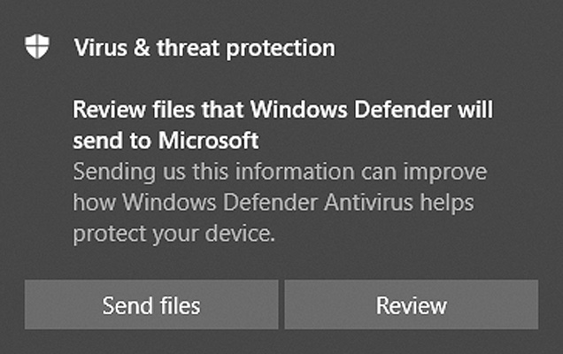
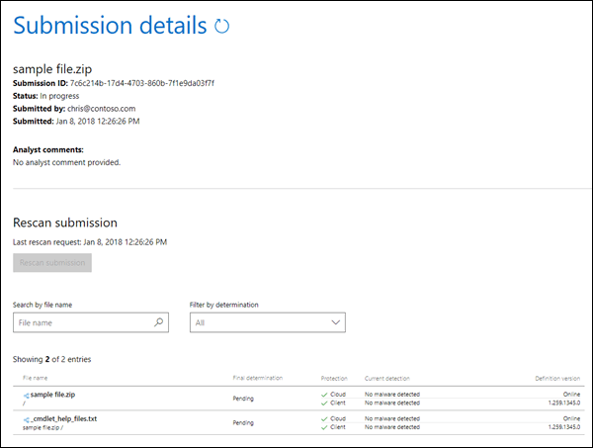
File Submission
If you have a file that you suspect might be malware or is being incorrectly detected, you can submit it to Microsoft for analysis.
Processing submissions take dedicated analyst resource. Analysis is prioritized by the number of file detections and the type of submission. Provide detailed information about the product you were using and what you were doing when you found the file.
Prioritized by potential impact, authenticated customer, enterprise customers with valid Software Assurance IDs (SAIDs). SAID submissions flagged as high priority and given immediate attention.
Samples cannot be submitted by email.
https://www.microsoft.com/en-us/wdsi/filesubmission/
Notes:
https://docs.microsoft.com/en-us/windows/security/threat-protection/intelligence/submission-guide
https://www.microsoft.com/en-us/wdsi/filesubmission

Slide 98
Question…
Which tool is used to dump credentials from Windows?
Notes:
Mimikatz can dump hashes and Kerberos tickets from Windows processes.
https://github.com/gentilkiwi/mimikatz

Slide 99
Emerging Threats

Slide 100
OASIS

Slide 101
OASIS CTI TC
Organization for the Advancement of Structured Information Standards (OASIS)
Cyber Threat Intelligence (CTI) Technical Committee (TC)
Individuals, organizations, and governments come together to solve some of the world’s biggest technical challenges through the development of open code and open standards.
In charge of the STIX and TAXII standards.
Notes:
OASIS Open - OASIS Open (oasis-open.org)

Slide 102
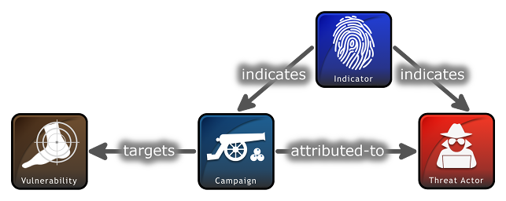
Structured Threat Information Expression (STIX™)
STIX, which was originally sponsored by the office of Cybersecurity and Communications within the United States Department of Homeland Security (DHS).
With STIX, all aspects of suspicion, compromise and attribution can be represented clearly with objects and descriptive relationships.
STIX information can be visually represented for an analyst or stored as JSON to be quickly machine readable. STIX's openness allows for integration into existing tools and products or utilized for your specific analyst or network needs.
STIX Objects categorize each piece of information with specific attributes to be populated. Chaining multiple objects together through relationships allow for easy or complex representations of CTI.
Notes:
Introduction to STIX (oasis-open.github.io)

Slide 103
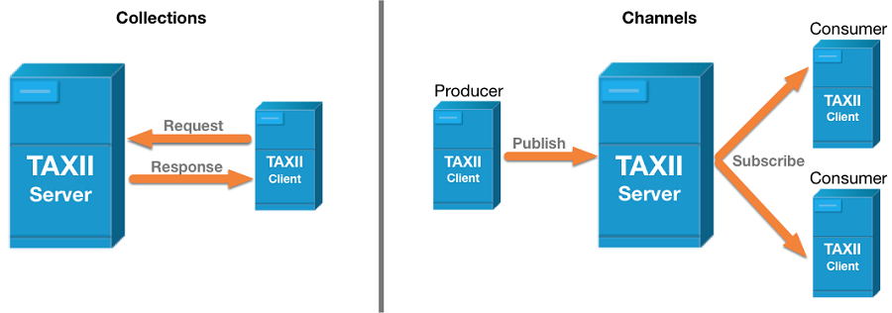
TAXII
Trusted Automated Exchange of Intelligence Information (TAXII™) is an application protocol for exchanging CTI over HTTPS.
Collection is an interface to a logical repository of CTI objects provided by a TAXII Server that allows a producer to host a set of CTI data that can be requested by consumers.
Maintained by a TAXII Server, a Channel allows producers to push data to many consumers and consumers to receive data from many producers

Slide 104
Question…
Which Microsoft product supports ingestion of STIX/TAXII feeds?
Notes:
Azure Sentinel
https://docs.microsoft.com/en-us/azure/sentinel/import-threat-intelligence

Slide 105
Best Practices

Slide 106
Best Practices
Educate end users about protecting personal and business information in social media, filtering unsolicited communication, identifying lures in spear-phishing email, and reporting of reconnaissance attempts and other suspicious activity.
Configure Office 365 email filtering settings to ensure blocking of phishing & spoofed emails, spam, and emails with malware. Set Office 365 to recheck links on click and delete sent mail to benefit from newly acquired threat intelligence.
Turn on attack surface reduction rules, including rules that can block advanced macro activity, executable content, process creation, and process injection initiated by Office applications.
Disallow macros or allow only macros from trusted locations.
Check perimeter firewall and proxy to restrict servers from making arbitrary connections to the internet to browse or download files. Such restrictions help inhibit malware downloads and command-and-control activity.

Slide 107
Best Practices (Cont)
Enforce strong, randomized local administrator passwords. Use tools like LAPS.
Practice the principle of least-privilege and maintain credential hygiene. Avoid the use of domain-wide, admin-level service accounts.
Require multi-factor authentication through Windows Hello.
Turn on cloud-delivered protection and automatic sample submission on Microsoft Defender Antivirus. These capabilities use artificial intelligence and machine learning to quickly identify and stop new and unknown threats.
Turn on tamper protection features to prevent attackers from stopping security services.
Monitor for clearing of event logs. Windows generates security event ID 1102 when this occurs.
Determine where highly privileged accounts are logging on and exposing credentials. Monitor and investigate logon events (event ID 4624) for logon type attributes. Highly privileged accounts should not be present on workstations.
Utilize the Microsoft Defender Firewall, intrusion prevention devices, and your network firewall to prevent RPC and SMB communication among endpoints whenever possible. This limits lateral movement as well as other attack activities.

Slide 108
Preventing Attacks
Keep software up-to-date
Be wary of links and attachments
Watch for compromised websites
Don’t use pirated materials
Don’t attach unfamiliar removable devices
Use non-administrator accounts
Use Strong passwords
Don’t use untrusted devices to login
Avoid running older apps
Notes:
https://docs.microsoft.com/en-us/windows/security/threat-protection/intelligence/prevent-malware-infection

Slide 109
Build Hands-on Lab: Attack Simulation
As a result of participating in this lab, you will be better able to Perform Attack Simulation
OUTCOMES
ACTIVITY
60 minutes
Independent
Table Group Channel & CloudLabs Environment
Independently review and complete Exercises 1-4 in the Lab 1 Guide.
Login to your CloudLabs environment and work through a set of tasks you would typically follow in work associated with ingesting and integrating your customer’s data.
The Lab Guide is available in the ‘Files’ tab of the General channel. Engage your Table Group call for support and troubleshooting.
Welcome | Keynote | Demo Walkthrough | Break | Data Loading & Data Lake Organization | Activity: Data Lake Design & Security Considerations | Break | Lab: Data Integration Part 1 | Break | Data Transformations | Activity: Data Engineering Discussion | Lab: Data Integration Part 2 | Closing

Slide 110
Thank You slide
Break

Slide 111
Preparing For The Worse

Slide 112
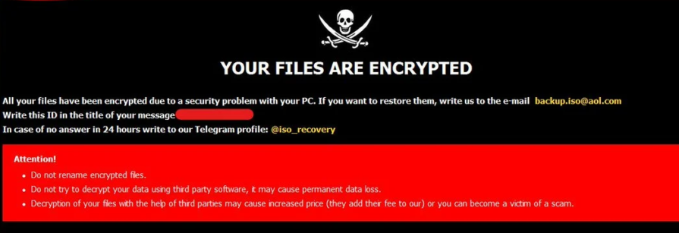
Bad Things Happen
Threats continue to be created and old threats evolve.
Supply chain attacks are proving to be the most destructive (Solarwinds)
Bad Things can still happen.

Slide 113
Ransomware
In 2020, the FBI’s Internet Crime Complaint Center received 2,474 ransomware complaints, and those are just the ones that got reported.
Cybersecurity Ventures expects that businesses will fall victim to a ransomware attack every 11 seconds in 2021, up from every 14 seconds in 2019, and every 40 seconds in 2016.
In 2020, the total number of global ransomware reports increased by 485% year-over-year according to the latest Threat Landscape Report 2020 by Bitdefender.

Slide 114
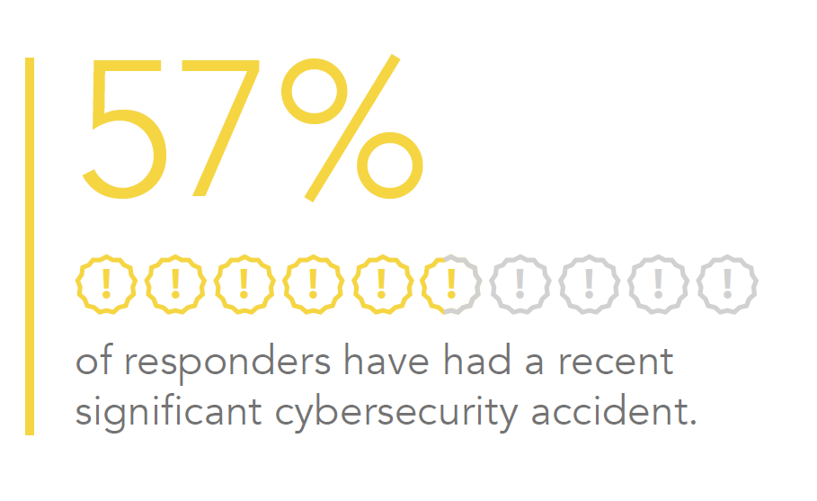
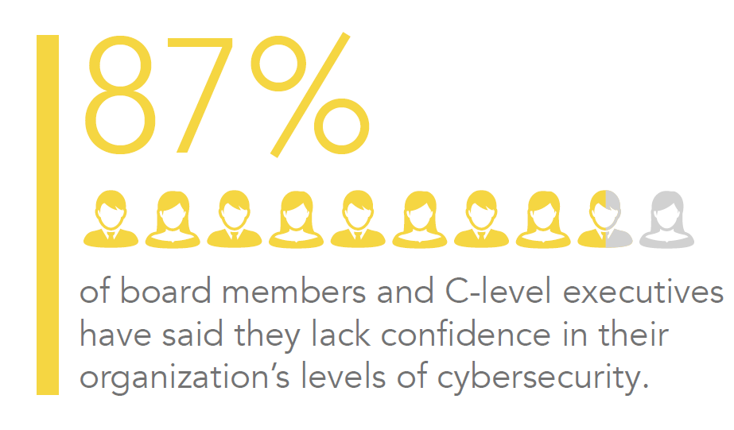
Some Data
Many organizations will experience a major incident or must respond to difficult questions about preventing, detecting, and successfully managing a cybersecurity attack from customers, partners, and the board of directors.
A 2016-2017 EY survey showed that 87% of board members and C-suite members lack confidence in their organization’s level of cybersecurity

Slide 115
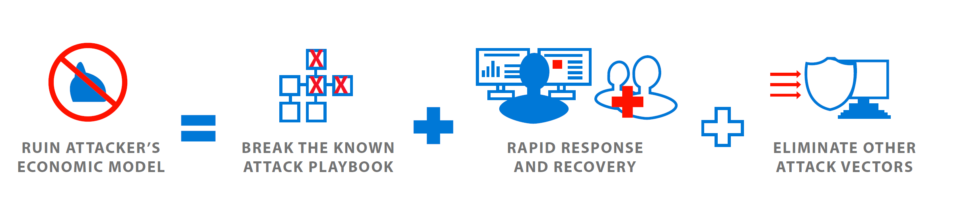
Ransomware (Cont)
A ransomware attack can be devastating for a home or a business.
Valuable and irreplaceable files can be lost and tens or even hundreds of hours of effort can be required to get rid of the infection and get systems working again.
Ransomware attacks continue to evolve and attack methods get more sophisticated all the time.
You don’t have to be part of the statistics. With good planning and smart practices, you can prevent ransomware from affecting your systems.

Slide 116
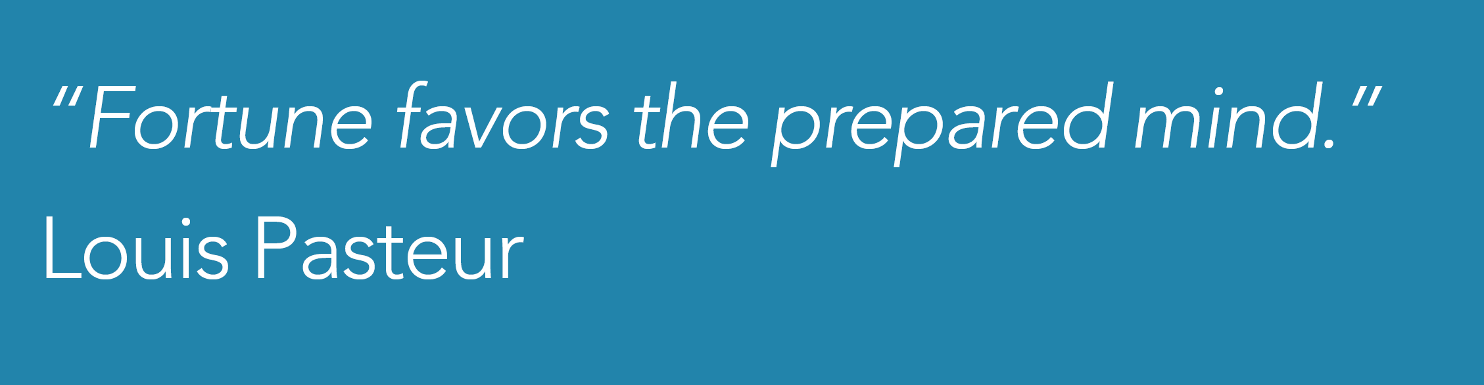

Slide 117
Prior To An Incident
Appoint a communications lead to be part of the core incident response team and confirm he or she understands the response process and cybersecurity.
Develop a communications portion of existing incident response plans, including clear ownership and approval processes
Map the stakeholders that may need to receive communications regarding an incident including customers, media, partners, regulators, employees and vendors.
Develop draft media holding statements and other materials for the major types of incidents that are of most concern to your company.
Host a table top exercise with members from the entire incident response team to test how they would react to the media, customer, and regulator attention due to an incident

Slide 118
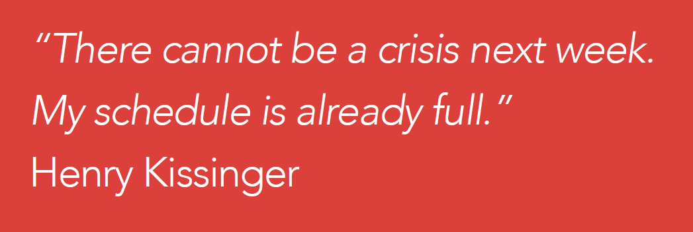

Slide 119
During an Incident
Keep calm – Incidents are extremely disruptive and can become emotionally charged. Stay calm and focus on prioritizing your efforts on the most impactful actions first.
Do no harm – Confirm your response is designed and executed in a way that avoids loss of data, loss of business-critical functionality, and loss of evidence. Avoid decisions can damage your ability to create forensic timelines, identify root cause, and learn critical lessons.
Be Accurate – Confirm anything you share to the public and to customers is correct and truthful.
Get help when needed – Investigating and responding to attacks from sophisticated attackers benefits significantly from deep expertise and experience.

Slide 120
Recovery Process
Isolate the Infection : Prevent the infection from spreading by separating all infected computers from each other, shared storage, and the network.
Identify the Infection : From messages, evidence on the computer, and identification tools, determine which malware strain you are dealing with. Determine its scope and the objective of the attack.
Report : Report to the authorities to support and coordinate measures to counter attack.
Determine Your Options : You have a number of ways to deal with the infection. Determine which approach is best for you.
Restore and Refresh : Use safe backups and program and software sources to restore your computer or outfit a new platform.
Prevent Recurrence : Make an assessment of how the infection occurred and what you can do to put measures into place that will prevent it from happening again.

Slide 121
Isolate the infection
Pull the network plug!
The first thing to do when a computer is suspected of being infected is to isolate it from other computers and storage devices.
Disconnect it from the network (both wired and Wi-Fi) and from any external storage devices.
Cryptoworms actively seek out connections and other computers, so you want to prevent that happening.
You also don’t want the ransomware communicating across the network with its command and control center.
Be aware that there may be more than just one patient zero, meaning that the ransomware may have entered your organization or home through multiple computers, or may be dormant and not yet shown itself on some systems.
Treat all connected and networked computers with suspicion and apply measures to ensure that all systems are not infected.

Slide 122
Identify the infection
Most often the ransomware will identify itself when it asks for ransom.
There are numerous sites that help you identify ransomware, including ID Ransomware.
The No More Ransom! Project provides the Crypto Sheriff to help identify ransomware.
Identifying the ransomware will help you understand what type of ransomware you have, how it propagates, what types of files it encrypts, and maybe what your options are for removal and disinfection.
It also will enable you to report the attack to the authorities, which is recommended.

Slide 123
Report
You’ll be doing everyone a favor by reporting all ransomware attacks to the authorities.
The FBI urges ransomware victims to report ransomware incidents regardless of the outcome.
Victim reporting provides law enforcement with a greater understanding of the threat, provides justification for ransomware investigations, and contributes relevant information to ongoing ransomware cases.
Knowing more about victims and their experiences with ransomware will help the FBI to determine who is behind the attacks and how they are identifying or targeting victims.
You can file a report with the FBI at the Internet Crime Complaint Center.

Slide 124
Legal
Maintain Confidentiality and Protect Privilege. Legal counsel (internal and/or external) should be positioned to direct the investigation and response efforts, generally in close partnership with the IT security lead, to identify legal obligations and manage risk
Identify Legal Statutory, Contractual, and Other Obligations. Statutory legal obligations are constantly shifting as statutory notification obligations are amended and (re)interpreted, changing the data elements and events that trigger notification obligations, and creating so-called notification safe harbors.
Take Care Regarding Post-Breach Actions/Statements. Understanding what to say – and what not to say – is critical to managing legal risk.
Engage Law Enforcement. Engaging law enforcement is now a key consideration in incident response. It is often required depending on industry (for example, certain government contractors) and type of data affected (for example, by major card brands in the case of a credit card breach).
Keep Executives/Board Members Adequately Informed. Increasingly, shareholders and regulators are scrutinizing C-suite and board members involvement in and oversight of cybersecurity incidents.

Slide 125
Determine your options
Your options when infected with ransomware are:
To pay the ransom.
To try to remove the malware.
To wipe the system(s) and reinstall from scratch.
It’s generally considered a bad idea to pay the ransom. Paying the ransom encourages more ransomware, and in many cases the unlocking of the encrypted files is not successful.
In a recent survey, more than three-quarters of respondents said their organization is not at all likely to pay the ransom in order to recover their data (77%). Only a small minority said they were willing to pay some ransom (3% of companies have already set up a Bitcoin account in preparation).
Even if you decide to pay, it’s very possible you won’t get back your data.

Slide 126
Microsoft Defender - Cleaning the Threat
Malware\Ransomware can be cleared, but the damage has probably already occurred
Provided you have the experience you can attempt to remove manually, or alternatively, use tools.
Microsoft provides several tools to prevent infection, but also tools to help remove them:
Microsoft Safety Scanner
Windows Defender Offline

Slide 127
Microsoft Safety Scanner
Microsoft Safety Scanner is a scan tool designed to find and remove malware from Windows computers.
Simply download it and run a scan to find malware and try to reverse changes made by identified threats.
Safety Scanner only scans when manually triggered and is available for use 10 days after being downloaded. We recommend that you always download the latest version of this tool before each scan.
Safety scanner is a portable executable and does not appear in the Windows Start menu or as an icon on the desktop. Note where you saved this download.
This tool does not replace your antimalware product.
Notes:
https://docs.microsoft.com/en-us/windows/security/threat-protection/intelligence/safety-scanner-download

Slide 128
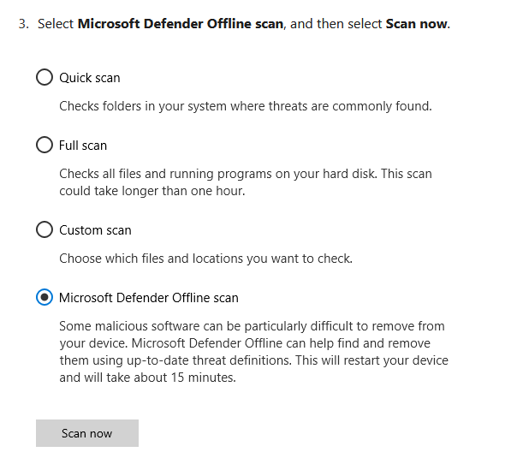
Windows Defender Offline
Microsoft Defender Offline is a powerful offline scanning tool that runs without starting your operating system in order to remove persistent threats.
Sometimes Microsoft Defender Antivirus might find malware that it can’t remove—for example, highly persistent malware such as rootkits.
If that happens, it will prompt you to run Microsoft Defender Offline, which is already installed with Windows 10.

Slide 129
Restore and Refresh
You have the choice of trying to remove the malware from your systems or wiping your systems and reinstalling from safe backups and clean OS and application sources.
The surest way of being certain that malware or ransomware has been removed from a system is to do a complete wipe of all storage devices and reinstall everything from scratch. Formatting the hard disks in your system will ensure that no remnants of the malware remain.
Be sure to determine the date of infection as well as you can from malware file dates, messages, and other information you have uncovered about how your particular malware operates.
Consider that an infection might have been dormant in your system for a while before it activated and made significant changes to your system.
Identifying and learning about the particular malware that attacked your systems will enable you to understand how that malware functions and what your best strategy should be for restoring your systems.

Slide 130
Restore and Refresh (3-2-1-1-0)
Backup files and systems (Azure Backup, OneDrive)
Use the 32110 data protection zip code
3 Different Copies of Data
2 Different Media
1 Offsite copy
1 copy is air-gapped or immutable
0 Errors after backup

Slide 131
Prevent Recurrence
Use anti-virus and anti-malware software or other security policies to block known payloads from launching.
Make frequent, comprehensive backups of all important files and isolate them from local and open networks.
Immutable backup options such as Object Lock offer users a way to maintain truly air-gapped backups. The data is fixed, unchangeable, and cannot be deleted within the time frame set by the end-user. With immutability set on critical data, you can quickly restore uninfected data from your immutable backups, deploy them, and return to business without interruption.
Object Lock functionality for backups allows you to store objects using a Write Once, Read Many (WORM) model, meaning after it’s written, data cannot be modified. Using Object Lock, no one can encrypt, tamper with, or delete your protected data for a specified period of time, creating a solid line of defense against ransomware attacks.

Slide 132
Prevent Recurrence (Cont)
Keep offline backups of data stored in locations inaccessible from any potentially infected computer, such as disconnected external storage drives or the cloud, which prevents them from being accessed by the ransomware.
Install the latest security updates issued by software vendors of your OS and applications. Remember to patch early and patch often to close known vulnerabilities in operating systems, browsers, and web plugins.
Consider deploying security software to protect endpoints, email servers, and network systems from infection.
Exercise cyber hygiene, such as using caution when opening email attachments and links.

Slide 133
Prevent Recurrence (Cont)
Segment your networks to keep critical computers isolated and to prevent the spread of malware in case of attack. Turn off unneeded network shares.
Turn off admin rights for users who don’t require them. Give users the lowest system permissions they need to do their work.
Restrict write permissions on file servers as much as possible.
Educate yourself, your employees, and your family in best practices to keep malware out of your systems. Update everyone on the latest email phishing scams and human engineering aimed at turning victims into abettors.

Slide 134
Question…
What tools can be used to backup on-premises and Azure-based virtual machines?
Notes:
Azure Backup / Recovery Services Vault.
https://docs.microsoft.com/en-us/azure/backup/backup-azure-recovery-services-vault-overview

Slide 135
Thank You slide
Break (15 mins)

Slide 136
Welcome Back!
Kick-Off | 8:00-8:05 | Welcome | Main Call
 | 8:05-8:30 | Attack Patterns + Analysis
 | 8:30-8:45 | Demo Walkthrough
Ingest | 8:45-9:00 | Break
 | 9:00-10:00 | Attack Patterns + Catching Attacks
 | 10:00-11:00 | Activity: Attack Patterns | Table Group Call
 | 11:00-12:00 | Build Hands-on: Attack Simulation
 | 12:00-1:00 | Long Break | Table Group Call
Transform | 1:00-2:00 | Windows Defender, Attack Analysis, Emerging Threats | Main Call
 | 2:00-2:30 | Restoring Systems
 | 2:30-2:45 | Break
 | 2:45-3:15 | Activity: Restoring Systems
 | 3:15-4:00 | Build Hands-on: Restoring Systems | Table Group Call
 | 4:00-4:15 | Closing | Main Call
Presentation/
Whole Group
Lab
Activity/ Discussion/ Group Work
Announcements

Slide 137
Breakout Activity: Restoring Systems
As a result of participating in this activity, you will better be able to how to restore Azure and on-premises systems
OUTCOMES
ACTIVITY
60 minutes
Learning Adviser
Table Group Channel
As a team review WWI requirements provided in student guide
Open the whiteboard and as a team answer the provided challenge questions.
The questions are pre-loaded into the whiteboard.
Welcome | Keynote | Demo Walkthrough | Break | Attack Patterns + Catching Attacks | Activity: Attack Patterns | Break | Lab: Attack Simulation | Long Break | Windows Defender, Attack Analysis, Threats | Restoring Systems | Activity: Restoring Systems | Lab: Restoring Systems | Closing

Slide 138
Build Hands-on Lab: Restoring Systems
As a result of participating in this lab, you will be better able to Restore Azure and on-premises systems
OUTCOMES
ACTIVITY
60 minutes
Independent
Table Group Channel & CloudLabs Environment
Independently review and complete Exercises 1-4 in the Lab 1 Guide.
Login to your CloudLabs environment and work through a set of tasks you would typically follow in work associated with ingesting and integrating your customer’s data.
The Lab Guide is available in the ‘Files’ tab of the General channel. Engage your Table Group call for support and troubleshooting.
Welcome | Keynote | Demo Walkthrough | Break | Attack Patterns + Catching Attacks | Activity: Attack Patterns | Break | Lab: Attack Simulation | Long Break | Windows Defender, Attack Analysis, Threats | Restoring Systems | Activity: Restoring Systems | Lab: Restoring Systems | Closing

Slide 139
Security Resources

Slide 140
Customer Training
Microsoft Defender for Endpoint Ninja Training - https://techcommunity.microsoft.com/t5/microsoft-defender-for-endpoint/become-a-microsoft-defender-for-endpoint-ninja/ba-p/1515647
CISO Workshop - https://docs.microsoft.com/en-us/security/ciso-workshop
Azure Sentinel Training – https://techcommunity.microsoft.com/t5/azure-sentinel/become-an-azure-sentinel-ninja-the-complete-level-400-training/ba-p/1246310
AZ-500 - https://docs.microsoft.com/en-us/learn/certifications/exams/az-500
SC-200 - https://docs.microsoft.com/en-us/learn/certifications/exams/sc-200

Slide 141
Security Resources
Twitter
Microsoft Security Intelligence - [@MsftSecIntel](https://www.twttier.com/MsftSecIntel)
Microsoft Intune - [@MSIntune](https://www.twttier.com/MsIntune)
Microsoft Security - [@msftsecurity](https://www.twttier.com/msftsecurity)
Microsoft Security Intelligence - [@msftsecurity](https://www.twttier.com/wsecurity)
Blogs
https://www.microsoft.com/security/blog/product/windows/
https://www.microsoft.com/security/blog/ciso-series/
Notes:
CISO series - Microsoft Security

Slide 142
Full Group Activity: Restoring Systems
Objective: As a result of participating in this activity, you will better be able to design a customer restoration strategy.
What you will be doing: The facilitator will be posting questions to the entire group using an interactive tool called Mentimeter. The answers you post using Mentimeter will then drive the discussion.
Total Activity Time: 30 minutes

Slide 143
Mentimeter Poll
Scan QR Code
or Go to www.menti.com and use code
1183 9575
Notes:
https://www.menti.com/9r2wwujwag

Slide 144
Closing
Thank you for your participation in today’s Microsoft Defender Boot Camp!
We learned:
MITRE ATT&CK
Attack Patterns
Attack Analysis
Restoring Systems
Best Practices
TODAY

Slide 145
Thank You slide
Thank you

Slide 147
Pop Quiz
TODO?
A) I.R.
B)
Linked Service
C)
Table
D) Activity

